Slide 1
Cork oak & SUBER model
The new version of the SUBER model – predicting multi products from the cork oak ecosystem

Slide 2
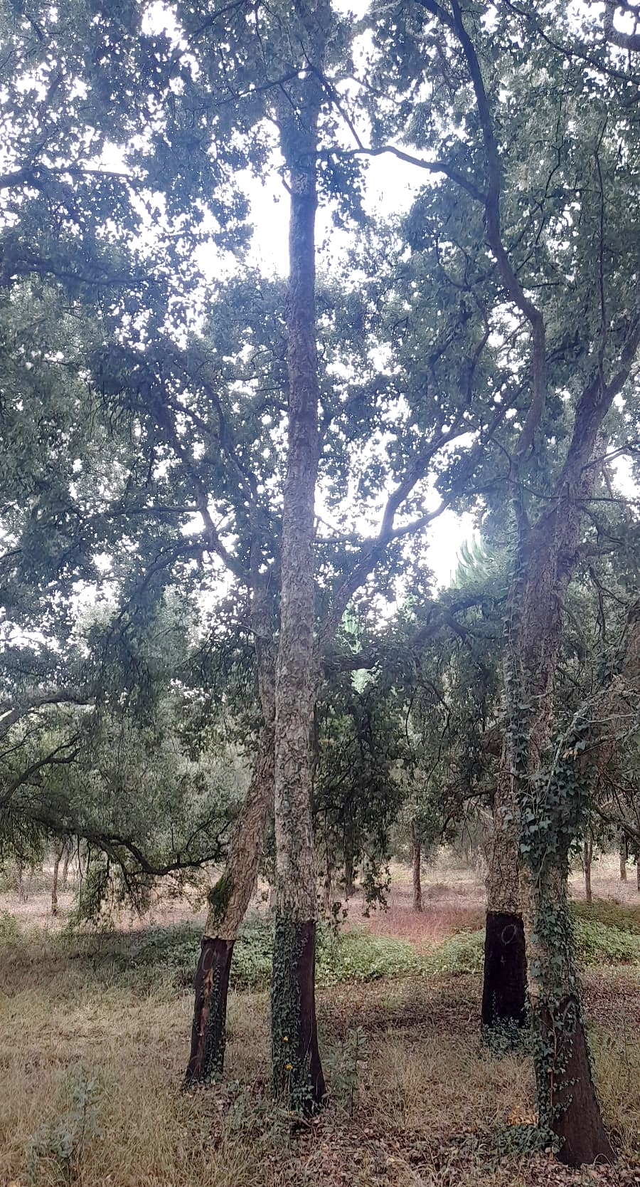
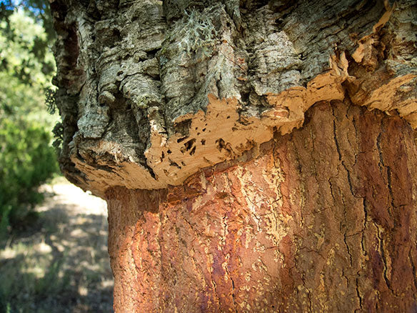
Specificity of the cork oak system in PORTUGAL
Cork oak stands are a very peculiar forestry system
the main product is not wood, but cork (bark)
afforestation through plantation or sowing, with initial densities higher than in the traditional stands, is relatively recent

Slide 3
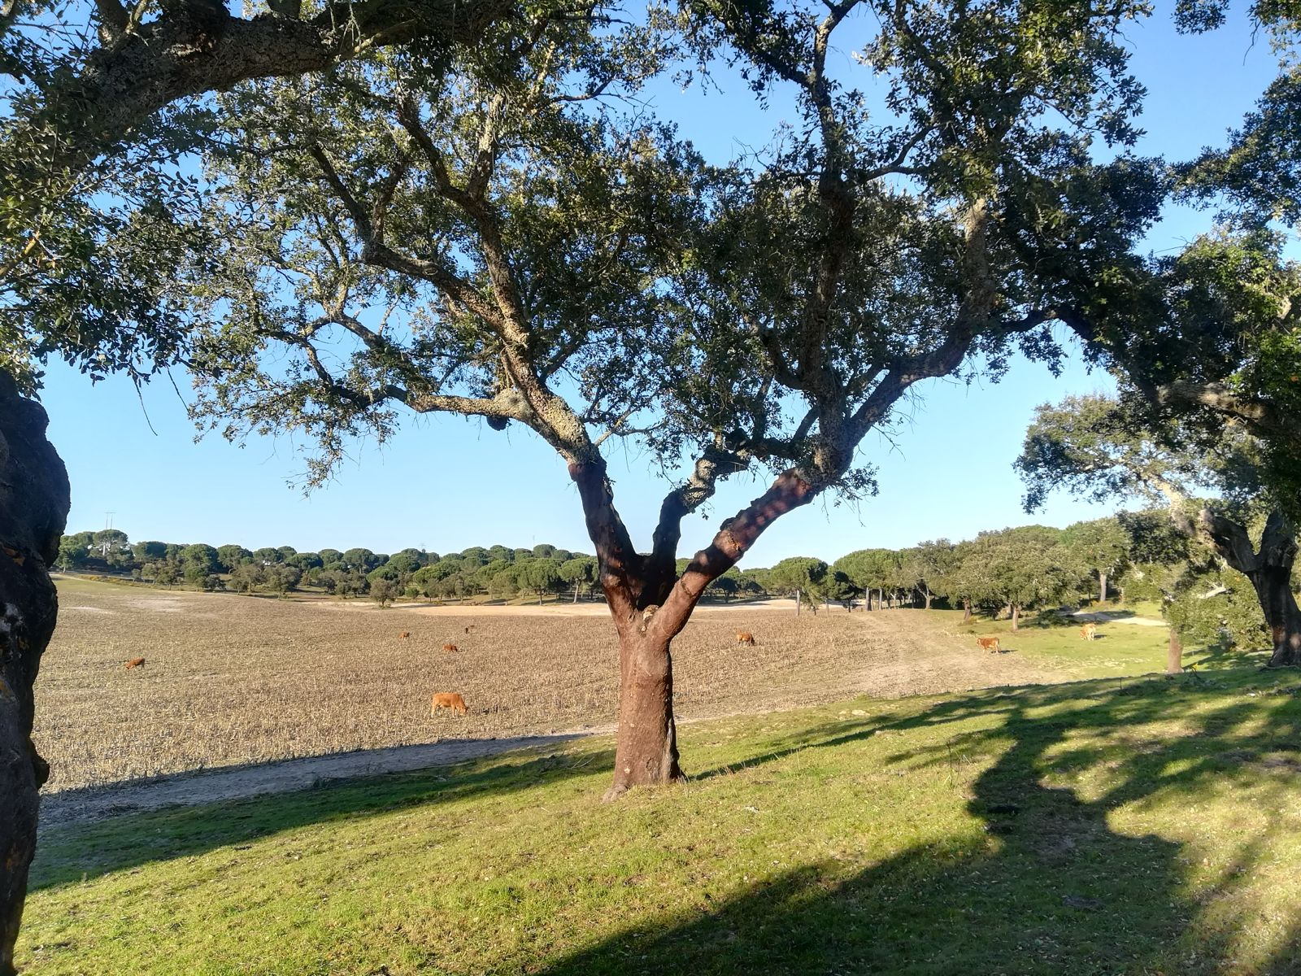
Specificity of the cork oak system in PORTUGAL
Cork oak stands are a very peculiar forestry system
It is an usual practice to grow agricultural crops or grass and herbage for cattle in association with the trees
Pruning is used:
i) to improve tree shape for cork stripping
ii) for fruit production

Slide 4


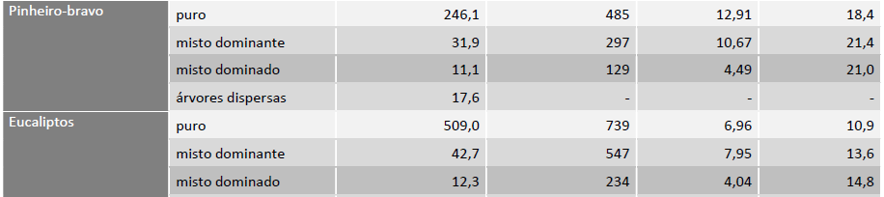

Specificity of the cork oak system in PORTUGAL
Cork oak stands are a very peculiar forestry system
Area (kha)
Stand density (trees ha⁻¹)
Basal Area (m² ha⁻¹)
dg (cm)
Cork oak
Pure
Dominant
dominated
Pure
Dominant
dominated
Maritime pine
Pure
Dominant
dominated
Eucalypt
NFI6 – 2025-2026

Slide 5
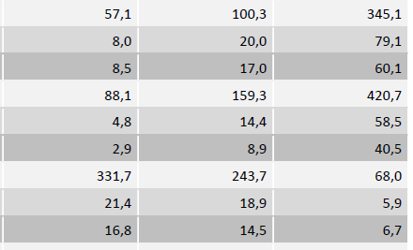
Specificity of the cork oak system in PORTUGAL
Cork oak stands are a very peculiar forestry system
Area (kha)
10< %CC <30
30< %CC <50
%CC >50
Cork oak
Pure
Dominant
dominated
Pure
Dominant
dominated
Maritime pine
Pure
Dominant
dominated
Eucalypt
NFI6 – 2025-2026

Slide 6
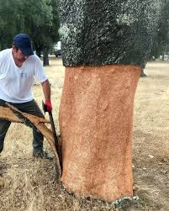
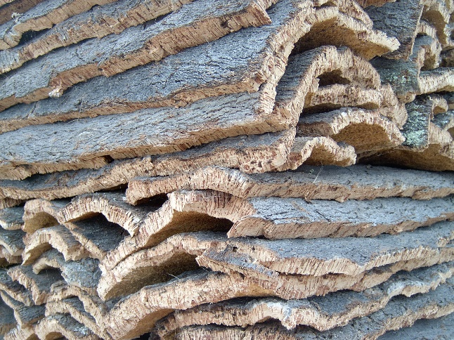
Specificity of the cork oak system in PORTUGAL
Some information about cork
Cork is a thick and continuous layer of suberised cells, produced by the meristematic cork cambium (phellogen), which makes up the external envelope of stem and branches
Usually, the first cork layer “virgin cork” is removed when the tree reaches a 70 cm perimeter overbark at breast height (between 20-40 years of age)
At that time, the maximum legal height for debarking is 2 times the perimeter at breast height (debarking coefficient = 2)

Slide 7
Specificity of the cork oak system in PORTUGAL
Some information about cork
The cork cambium is destroyed during the cork stripping process
The ability of regenerating a new cambium in the inner part of the bark ensures sustainable production
cork back
phellogen
cork
bark
wood

Slide 8
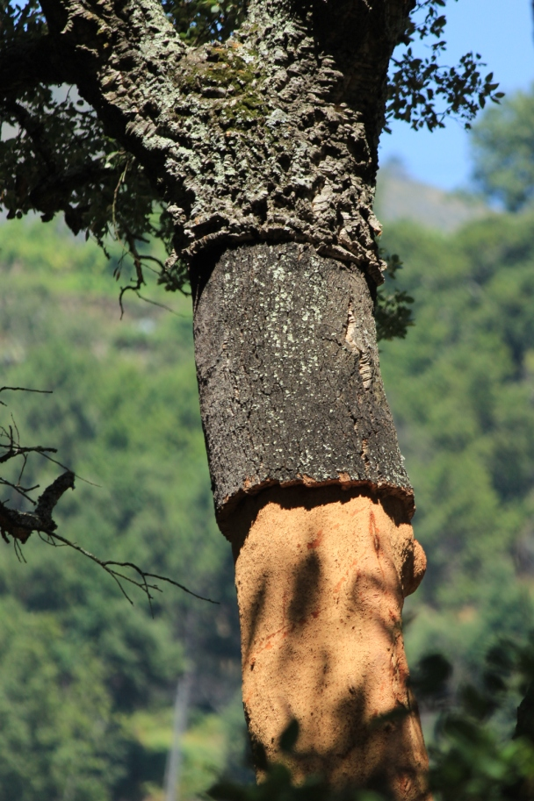
Specificity of the cork oak system in PORTUGAL
Some information about cork
Virgin cork
After the first debarking the new phellogen starts producing new layers of cork cells, originating the “second cork”, being cork cells production higher in the years immediately after debarking
In most regions, 9 years of cork growth allow to obtain a thickness suitable for the production of cork wine stoppers
The maximum legal height for second cork debarking is 2.5 times the perimeter at breast height (debarking coefficient = 2.5)
Second cork

Slide 9
Specificity of the cork oak system in PORTUGAL
Some information about cork
Virgin cork
After the extraction of the second cork, a new phellogen is again regenerated, cork properties stabilize in the following extractions – “mature cork”
Maximum legal height for mature cork debarking is 3 times the perimeter at breast height (debarking coefficient = 3)
Mature cork is extracted periodically (9 years is the most common rotation period) and the process can be sustained until the tree is quite old, sometimes 150-200 years
Second cork

Slide 10
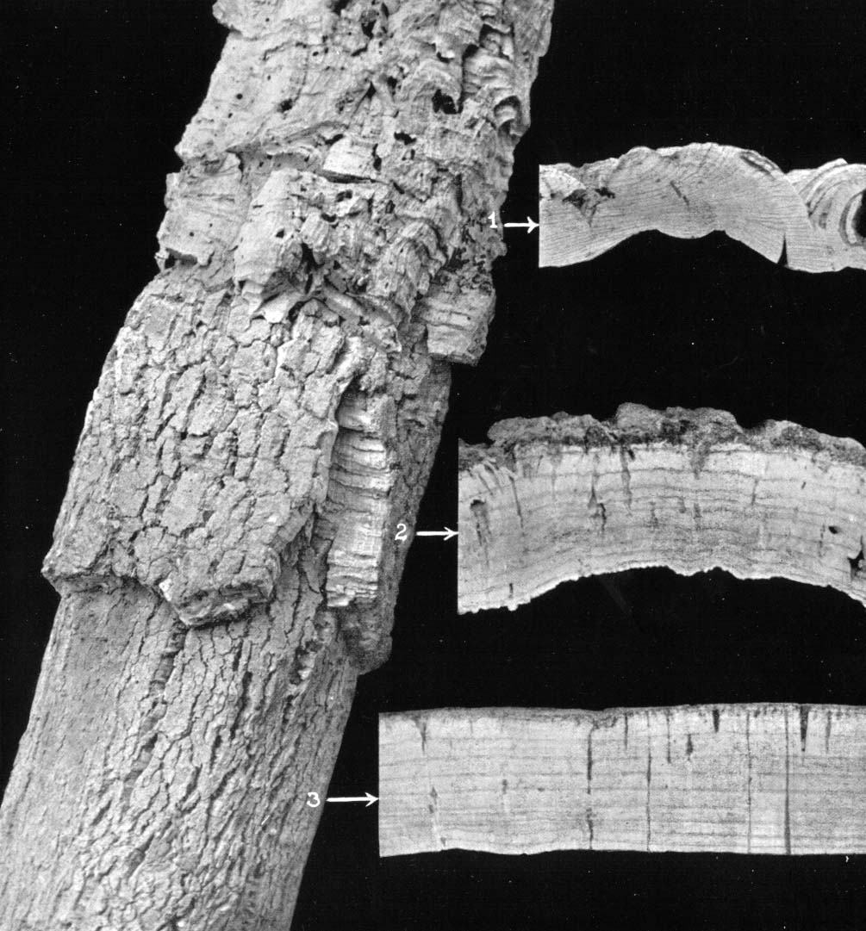
Specificity of the cork oak system in PORTUGAL
Some information about cork
Virgin cork
Second cork
Mature cork

Slide 11
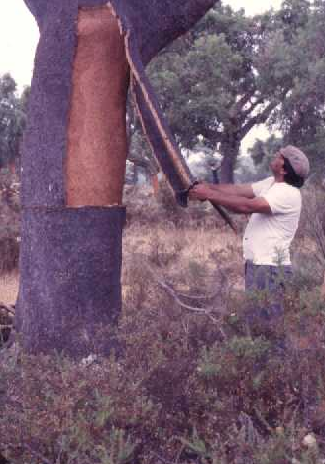
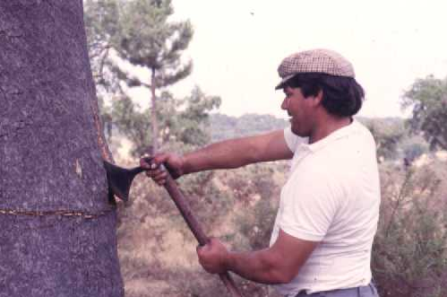
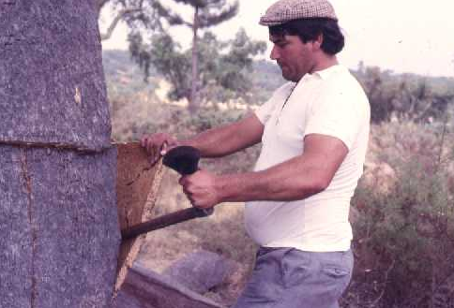
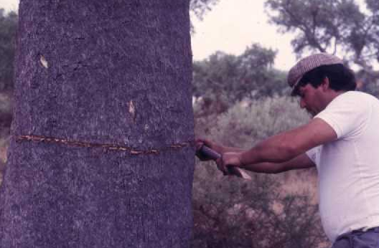
Specificity of the cork oak system in PORTUGAL
Some information about cork extraction

Slide 12
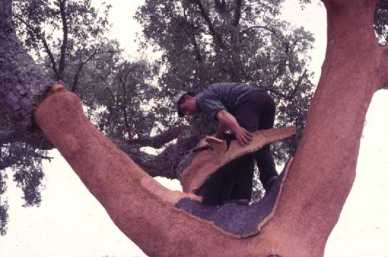
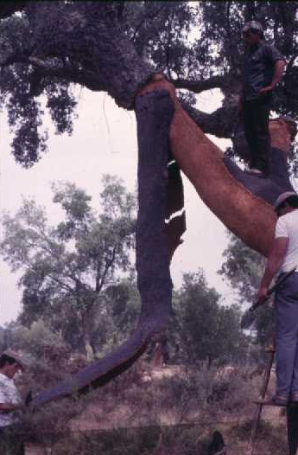
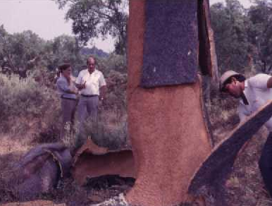
Specificity of the cork oak system in PORTUGAL
Some information about cork extraction
Range of tree production per harvest
7 - 11 kg / m² debarked area
Up to 150 kg per tree in one harvest

Slide 13
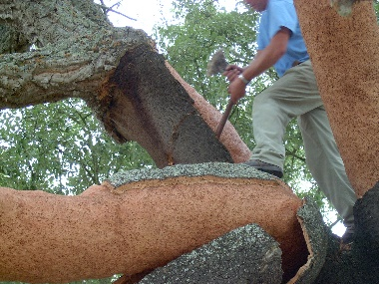
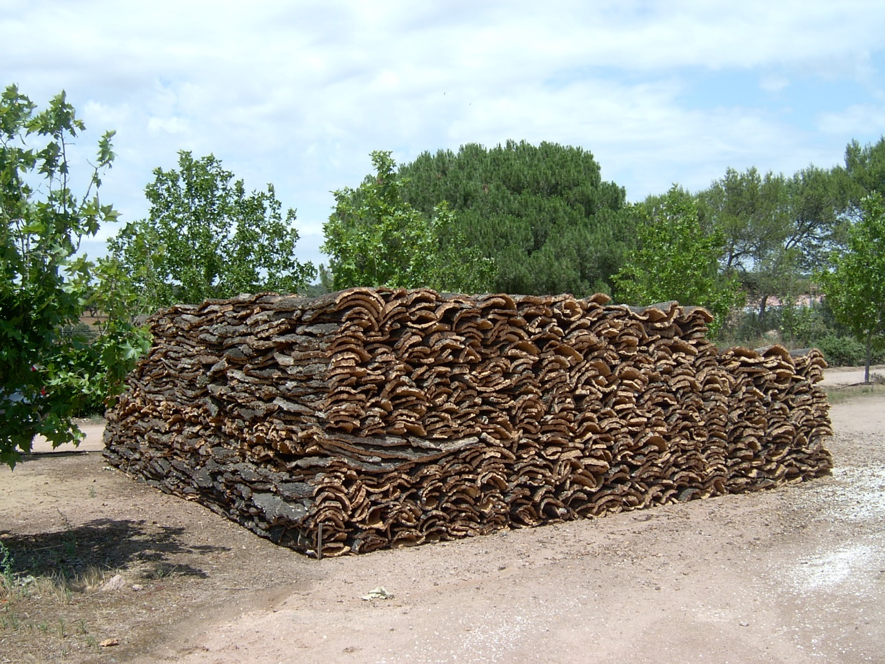
Specificity of the cork oak system in PORTUGAL
Some information about cork extraction
After extraction, cork used to be stored in large stacks in the farm, lately for the fear of being stolen it is being avoided
Time between harvest and processing is about 6-8 months

Slide 14
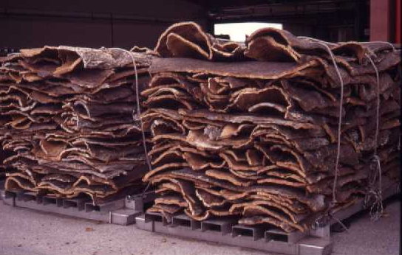
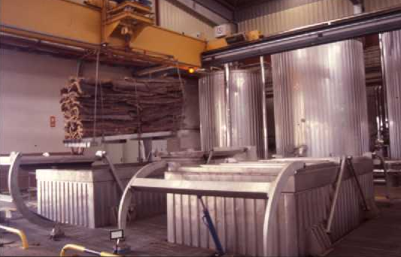
Specificity of the cork oak system in PORTUGAL
Some information about cork processing
Raw cork is then transported to the mill where it will be processed
Before processing cork is boiled in water in autoclaves at ambient pressure during 1 hour

Slide 15
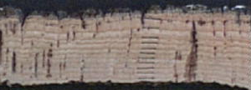
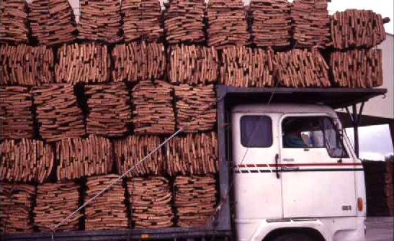
Specificity of the cork oak system in PORTUGAL
Some information about cork processing
Dimension expansion with boiling: radial – 10-15% ~12% tangential and axial – 5%

Slide 16
SUBER model

Slide 17

SUBER model
The first growth and yield model for cork oak was not developed in 1997
Its first version was developed based on:
  existing data
  published findings
  empirical knowledge of cork oak forests
Aims:
  establishing a modelling methodology suited to the specific characteristics of the species
  identifying areas for further research
CEF is currently using SUBERv ~ 5.5 (available at simflor.online)
ongoing research will soon culminate in SUBER v6.0

Slide 18
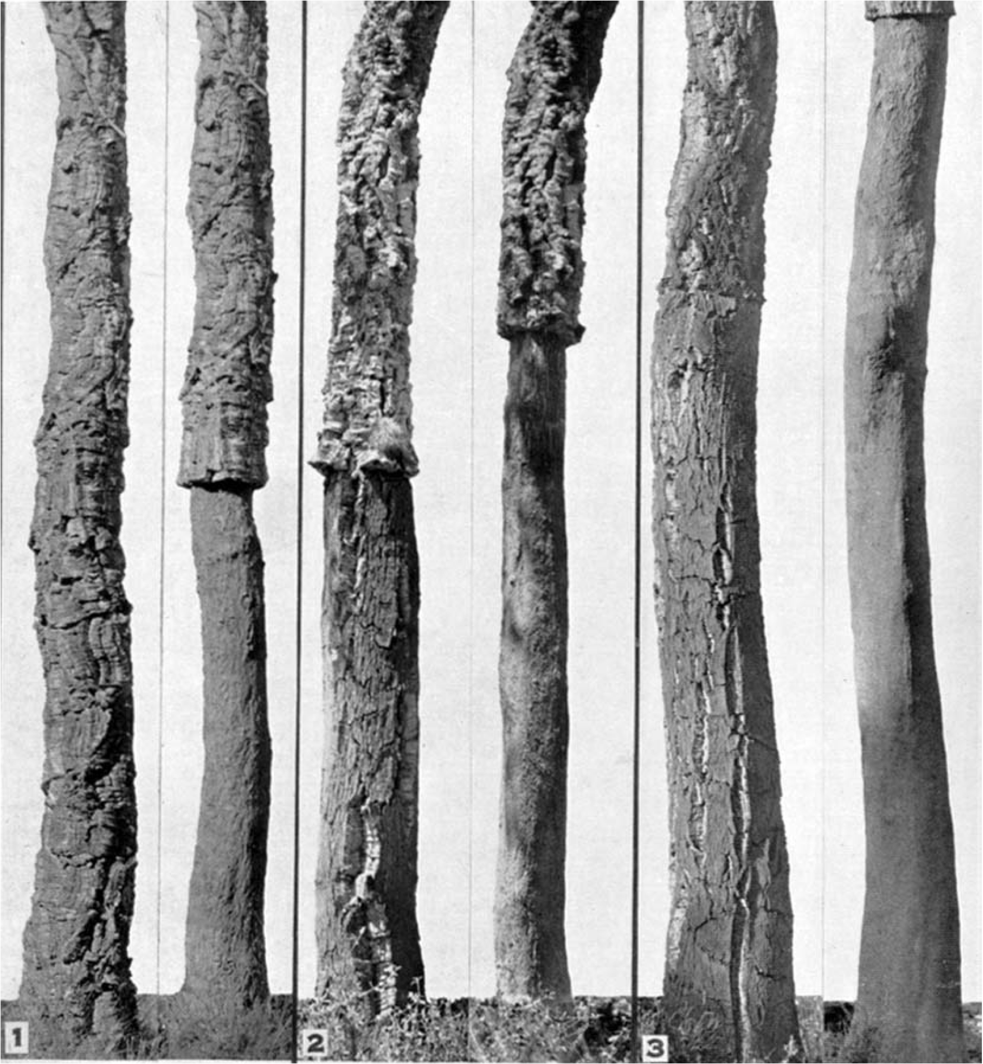
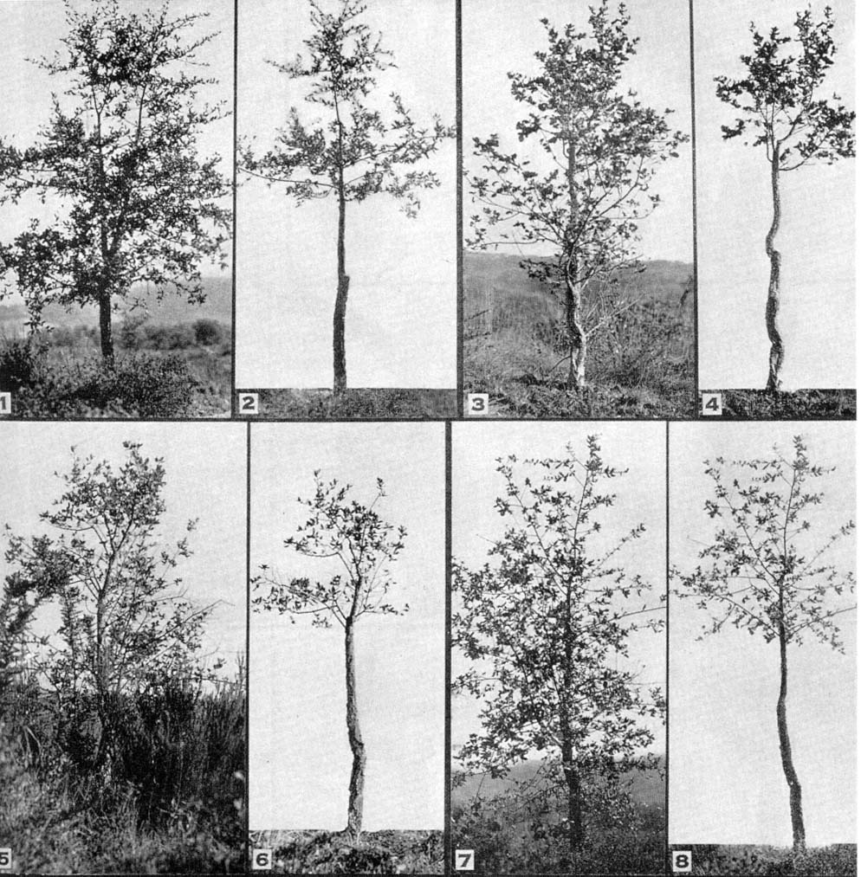
SUBER model – modules
Modelling Options
  The model considers 4 development stages:
    Regeneration
    Juvenile
    Intermediate
    Mature
h=3.0 m
Regeneration
Juvenile
Intermediate
Mature

Slide 19
SUBER model
Modelling Options
  For each development stage the model has specific equations, sub-models or distributions:
    To simulate tree diameter (over and underbark) and tree height
    To simulate stem height and nr of branches
    To predict crown diameter
    To simulate cork growth
    To predict cork weight by
    quality x caliber classes

Slide 20
SUBER model
Modelling Options
  For each development stage the model has specific equations, sub-models or distributions:
    Cork growth was assessed after boilling
    Cork growth simulation considers full years
    Cork caliber is predicted as a function of:
      cork age;
      cork growth índex;
      or
      cork thickness (complete years)
Calibre = espessura + costa + 1/2s anos

Slide 21
SUBER model
Estimation of site productivity
Model initialization
  in which the model simulates the variables that are not available from forest inventory
Simulation of the growth of each tree (individual tree model)
Simulation of cork parameters
  cork growth, evolution of cork thickness, cork weight prediction, cork quality
Simulation of silvicultural practices
  Thinning (uniform system, selection system)
  Regeneration
Non-cork products and services

Slide 22
SUBER model
Stand at age t
Inicialialization
Complets forest inventory missing data
Growth
module to predict the growth of trees and cork
Predict mortality
Stand at age t+1
After thinning
t=t+1
Stand at age t+1
N
N
Debarking
?
Thin
Thinning
?
y
y
Stand at age t+1
após descortiçamento
Debark
Predict cork weight

Slide 23
SUBER model – modules
Modules:
  Prediction of site productivity

Slide 24
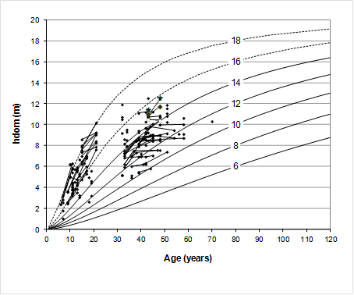
SUBER model – modules
Prediction of site productivity
  The site index curves for cork oak developed for Spain – Mariola Gonzaléz – were used to estimate site index (S) for each plot
  The development of this module was based on several plots established in juvenile stands (known age) representative of the cork oak stands in Portugal (contrasting climate and soil). Each site was object of a detailed characterization of:
    the soil, including the study of the whole profile
    climate through the nearest weather station (IM) and by available soil digital information
  The relationship between S and climate and soil characteristics was then modeled (reduced model and full model)
  Additionally, another model based on quantilic regression was developed and integrated into StandsSIM.md

Slide 25
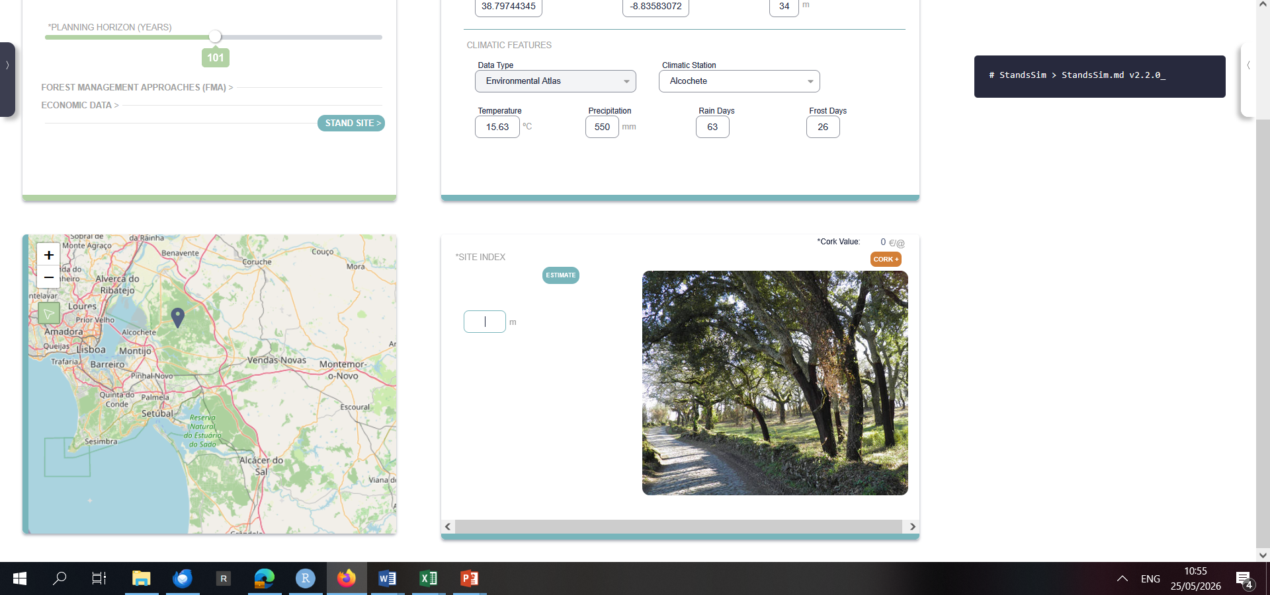
SUBER model – modules
There are three ways to predict S

Slide 26
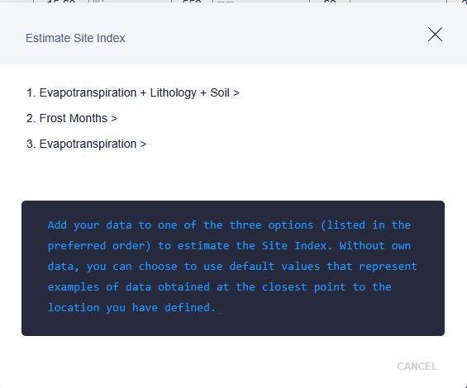
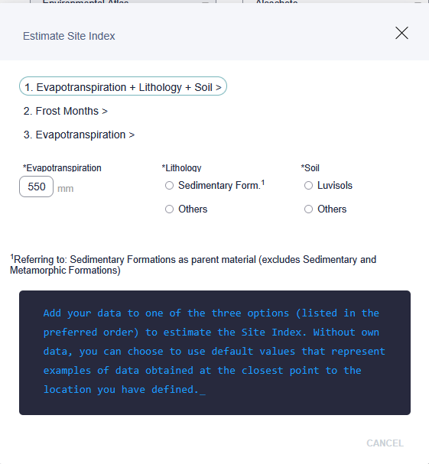
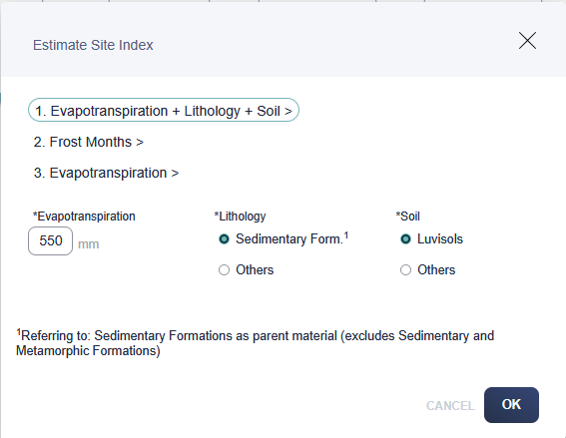
SUBER model – modules
There are three ways to predict S

Slide 27
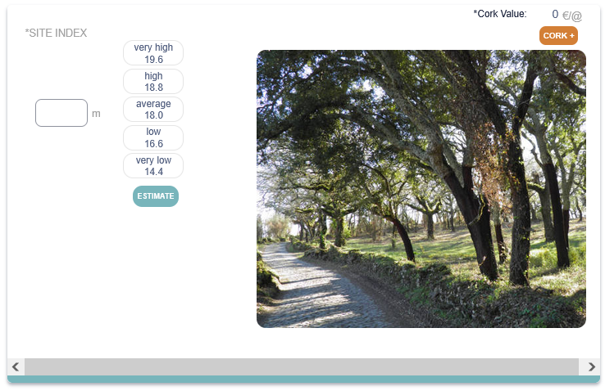
SUBER model – modules
There are three ways to predict S

Slide 28
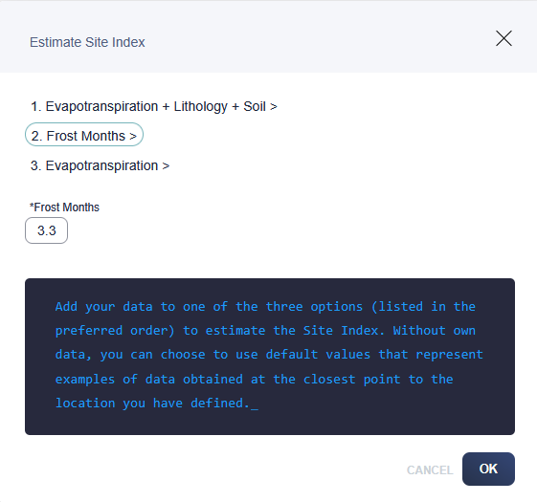
SUBER model – modules
There are three ways to predict S

Slide 29
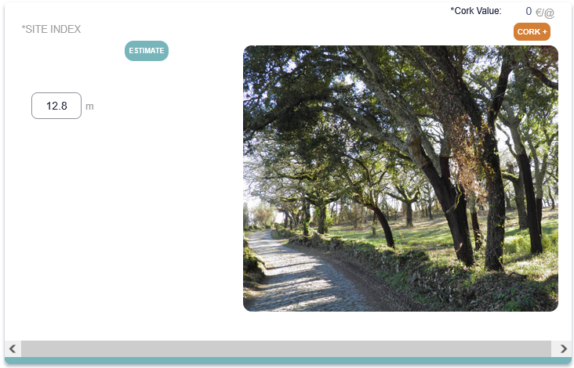
SUBER model – modules
There are three ways to predict S

Slide 30
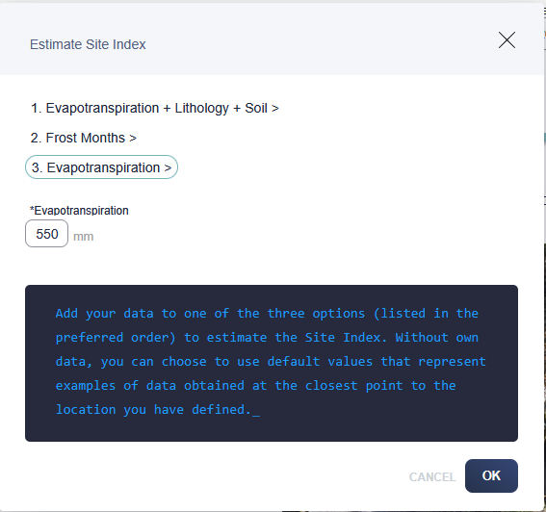
SUBER model – modules
There are three ways to predict S

Slide 31
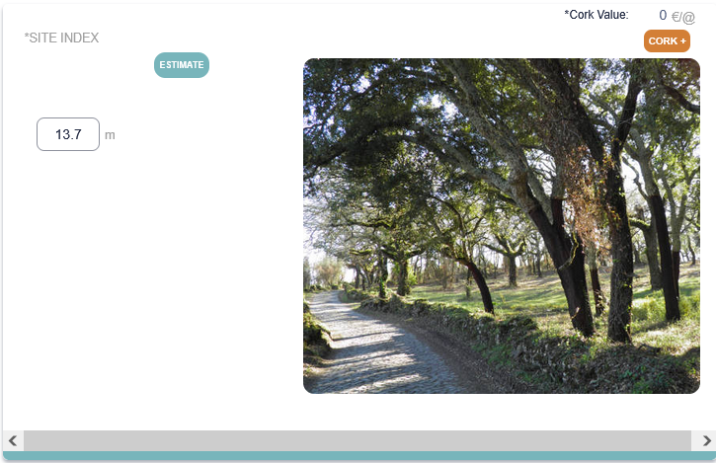
SUBER model – modules
There are three ways to predict S

Slide 32
SUBER model – modules
Modules:
  Methodology to estimate site productivity
  Height growth for trees in the regeneration stage

Slide 33
Growth of trees in the regeneration stage
The growth model for trees in the regeneration stage was based on data from provenance and regeneration trails (M. H. Almeida)
  Dominant height growth is modeled with the Spanish site index curves
  Mean and minimum tree heights are predicted from dominant height
  Height distribution is modeled from those variables
  Each tree is given a height according to the height distribution

Slide 34
SUBER model – modules
Modules:
  Methodology to estimate site productivity
  Height growth for trees in the juvenile stage
  Transition between the regeneration and juvenile stages
  Diameter growth model for the juvenile stage

Slide 35
Transition regeneration → juvenile
The transition of a tree from the regeneration to the juvenile stage was modelled with data from a large set of plots established in juvenile stands
  When a tree attains a height = 3 m, it comes to the juvenile stage and its diameter is predicted (with some random effect added):
  From then on tree dbh growth is modeled with an equation specifically developed for this stage:

Slide 36
SUBER model – modules
Modules:
  Methodology to estimate site productivity
  Height growth of trees in the juvenile stage
  Transition between the regeneration and juvenile stages
  Diameter growth model for trees in the juvenile stage
  Transition between the juvenile and adult stages
There is no difference in modelling intermediate and mature

Slide 37
Transition juvenile → adult
The transition of a tree from the juvenile to the adult stage includes three sub-models:
  Decision about debarking (for even-aged stands, when p% of the trees have a dg>22.28 cm)
  Prediction of diameter under cork
  Simulation of height of branching (stem height)
  Simulation of the number of branches that will be debarked
    Monte-Carlo simulation using observed distributions by NUTII or a user defined distribution

Slide 38
SUBER model – modules
Modules:
  Methodology to estimate site productivity
  Height growth of trees in the juvenile stage
  Transition between the regeneration and juvenile stages
  Diameter growth model for trees in the juvenile stage
  Transition between the juvenile and adult stages
  Diameter growth model for trees in the adult stage

Slide 39
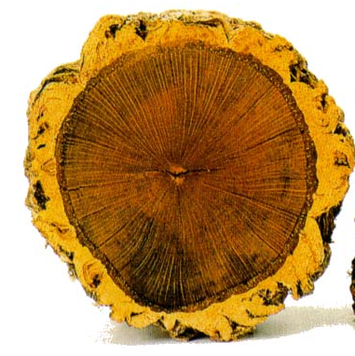
SUBER model – modules
data from stem analysis

Slide 40
Growth of trees in the adult stage
Diameter under cork growth model for dominant trees was developed using the Richards function formulated as an age-independent difference equation
k parameter
  If stand age is known, Si can be directly estimated, if not it can be predicted from soil and climate characteristics
  Genetic variability is simulated through the k parameter
  Tree height and crown diameter are also predicted with prediction functions common to juvenile and mature stages

Slide 41
SUBER model – modules
Modules:
  Methodology to estimate site productivity
  Height growth for trees in the juvenile stage
  Transition between the regeneration and juvenile stages
  Diameter growth model for trees in the juvenile stage
  Transition between the juvenile and adult stages
  Diameter growth model for trees in the adult stage
  Prediction of cork weight as a function of cork age

Slide 42
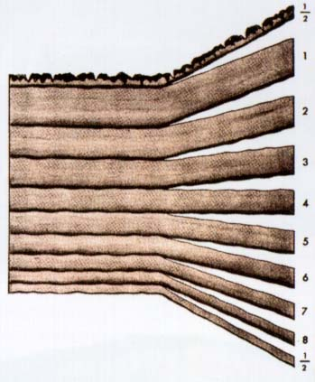
Modelling options - cork growth
Example with a cork with 9 years
1st half year
total cork thickness
(caliber)
8 complete years
(cork growth index)
last half year

Slide 43
Modelling options - cork growth
Cork growth sub-models:
  juvenile stage
    1st cork thickness distribution
  intermediate and mature stages
    cork growth prediction (complete years)
    total cork thickness prediction
        (as a function of the thickness of complete years)
    evolution of cork growth index (cgi) through successive cork extractions

Slide 44
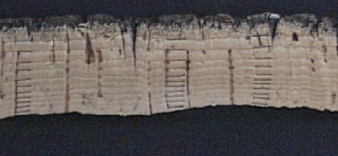
SUBER - cork growth
Data from cork ring measurements in cork samples with ages ranging from 7 to 16 years

Slide 45
SUBER - cork growth
Data on the relationship between total cork thickness and thickness of complete rings
To transform the thickness of complete rings into caliber
It was difficult to model incomplete cork rings
Data from cork ring measurements in cork samples with ages ranging from 7 to 16 years

Slide 46
Modelling options - cork growth
Predict cork caliber with 9 years from a measurement taken in a 4 years’ cork
Start with cork caliber with 4 years
(field measurement)
Discount the cork back and the 2 half years to obtain cork the thickness in 3 complete years
Predict cork thickness in 8 complete years
Predict cork caliber with 9 years

Slide 47
Modelling options - cork growth
Evolution of cgi in sucessive debarkings
cgi
Successive debarkings

Slide 48
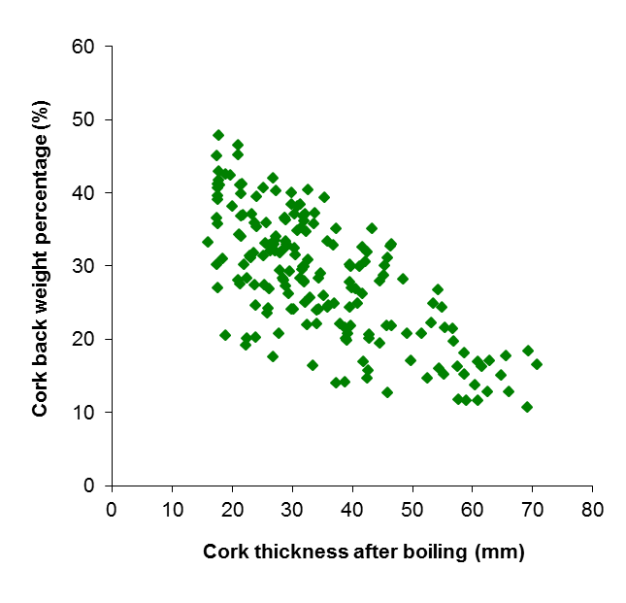

Modelling options - cork growth
Prediction of cork weight using cork age
Equation to predict cork weight for corks with 9 years
% of cork back (in weight)
Equation to predict % cork back weight at 9 years of age (cbp₉)
Estimate the biomass of cork tissue free from the cork back
Estimate the cork biomass for t years of growth without cork back
Estimate the cork biomass for t years of growth with cork back

Slide 49
SUBER model – modules
Modules:
  Methodology to estimate site productivity
  Height growth of trees in the juvenile stage
  Transition between the regeneration and juvenile stages
  Diameter growth model for trees in the juvenile stage
  Transition between the juvenile and adult stages
  Diameter growth model for trees in the adult stage
  Prediction of cork weight as a function of cork age
  Simulation of thinnings

Slide 50
Simulation of thinnings
The SUBER 3 model was used to simulate the development of several plots with alternative thinning strategies
These simulated data were used to develop a model that predicts the probability of a tree to be thinned (logistic regression):
Where:
Rdm = d/dg
RCE = relative spacing measure
Trees are “thinned” with Monte-Carlo simulation:
  Uniform system: all trees at the same time (even-aged)
  Selection system: by diameter class, towards a target distribution (uneven-aged)

