Slide 1

MODELS & SIMULATORS
in Portugal
Simflor.online\StandsSIM.md
Challenges in modelling the Montado evolution and cork production using the SUBER model (2026)
Susana Barreiro, Nuno Leitão, Margarida Tomé
Instituto Superior de Agronomia
Universidade de Lisboa

Slide 2
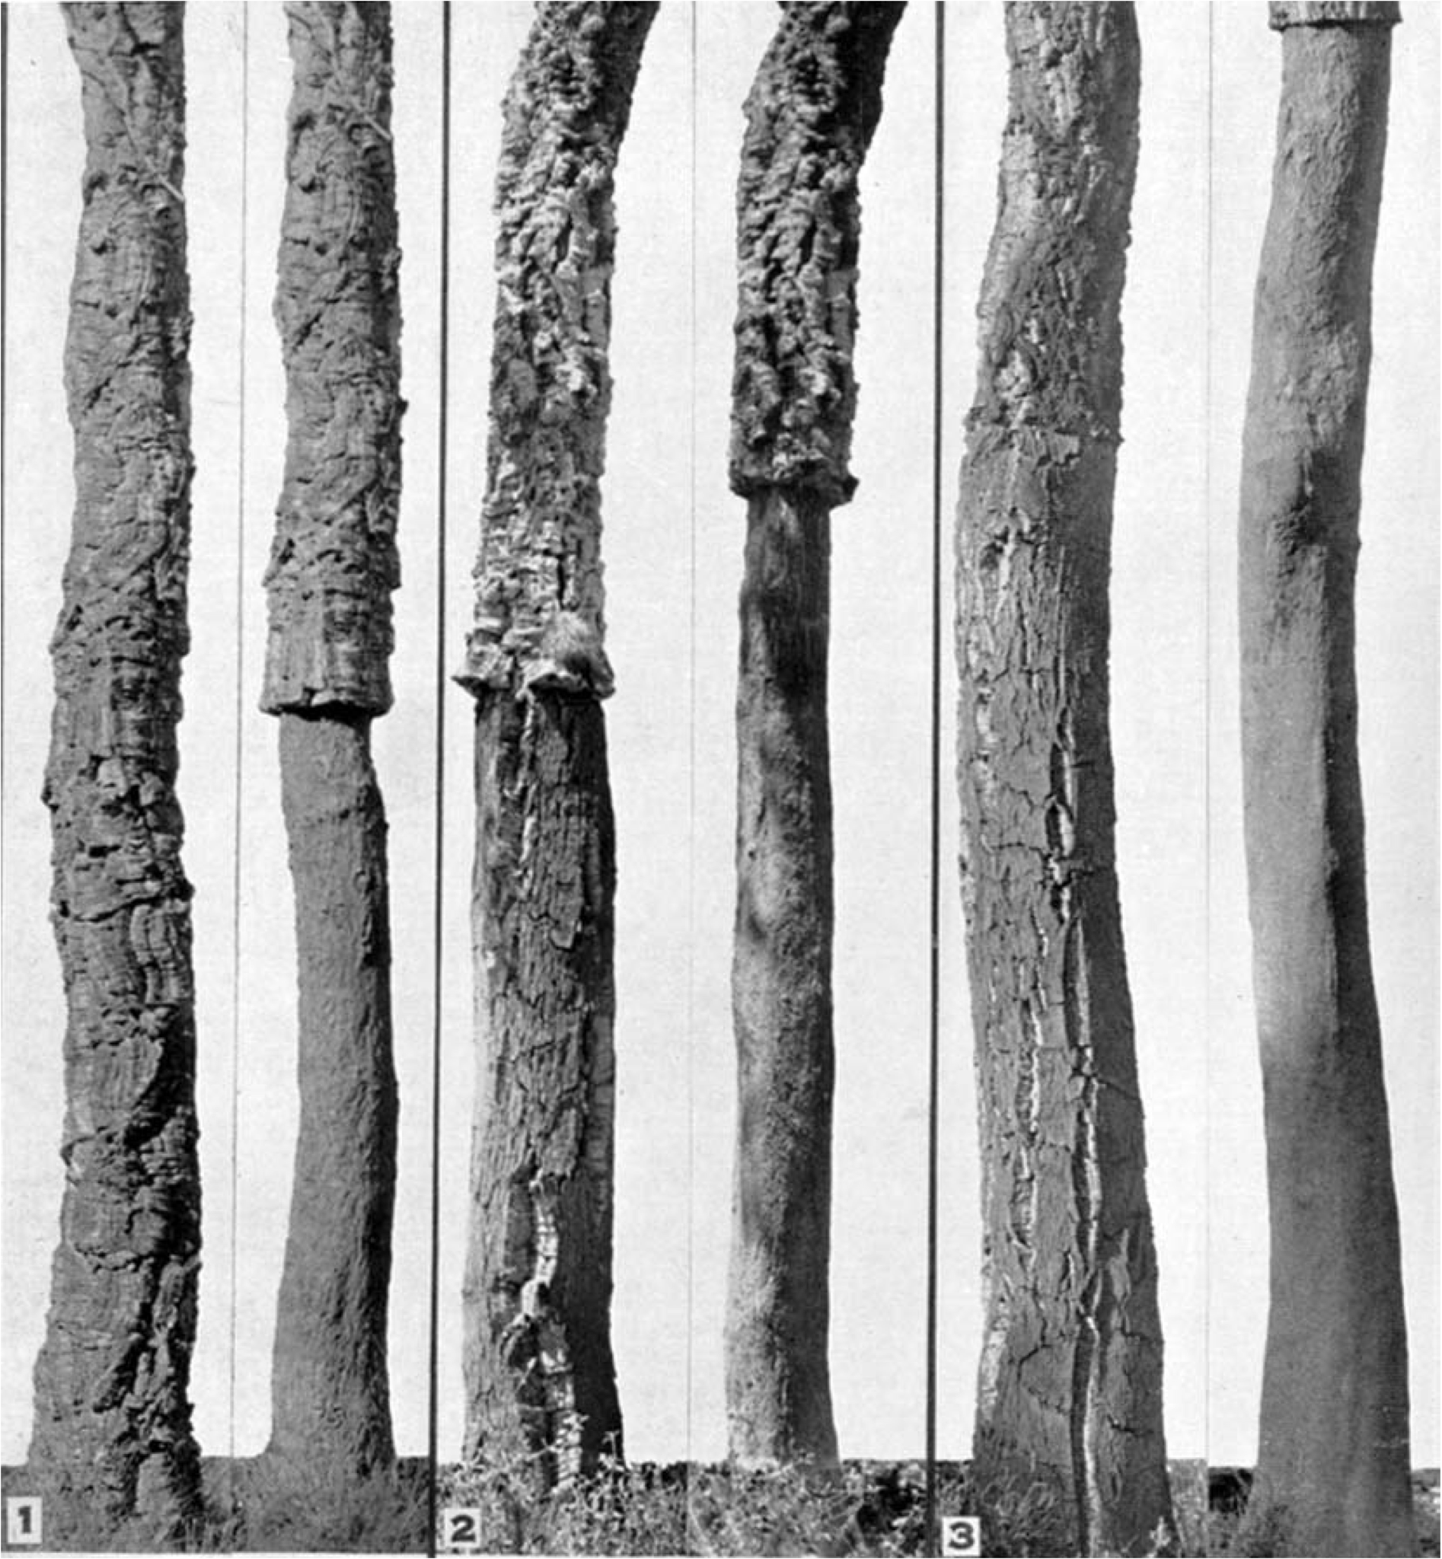
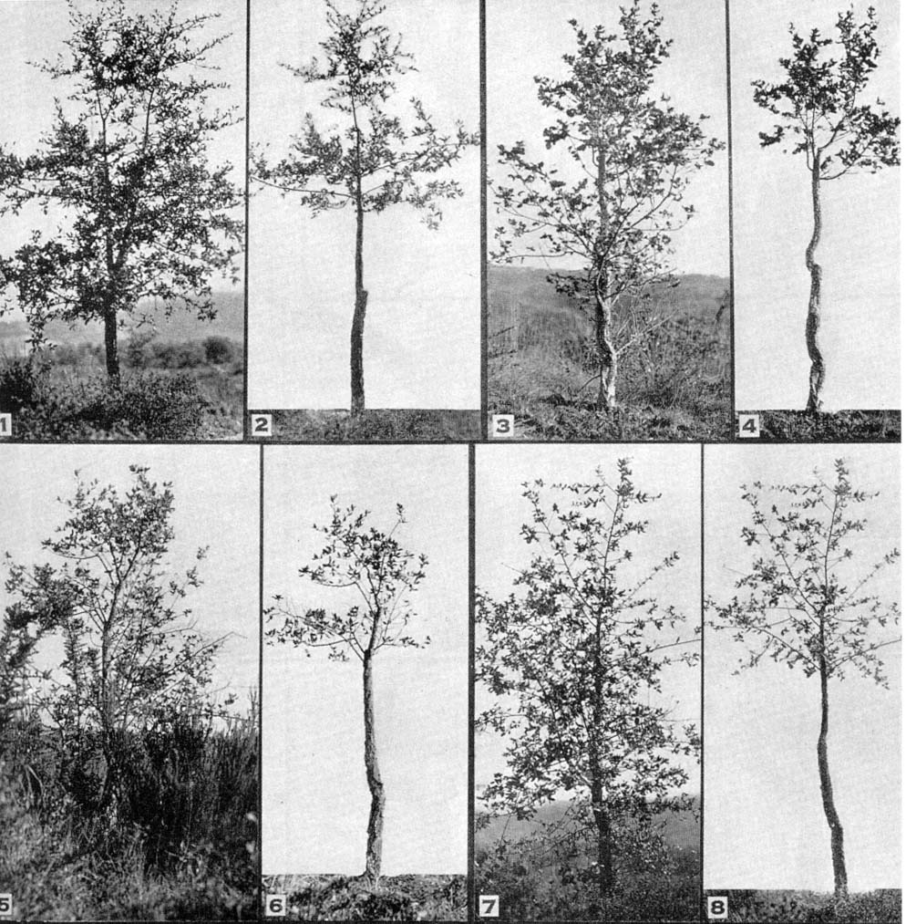
StandsSIM.md simflor.online SUBER Model – cork oak
Modelling options:
The model considers 4 development stages
  regeneration
  juvenile
  intermediate
  adult
h=3.0 m
Juvenile
Intermediate
Adult
Regeneration

Slide 3
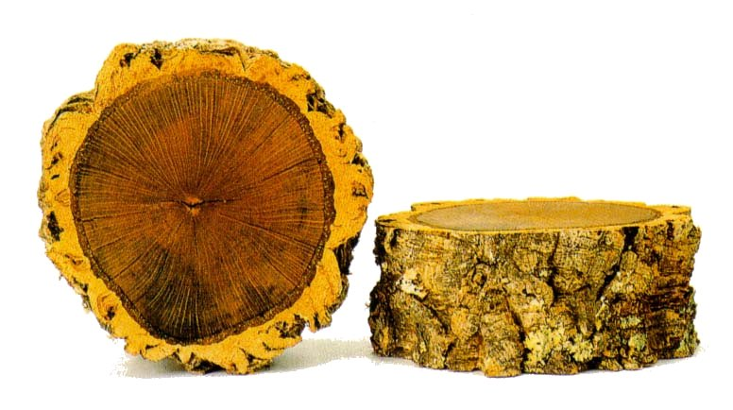
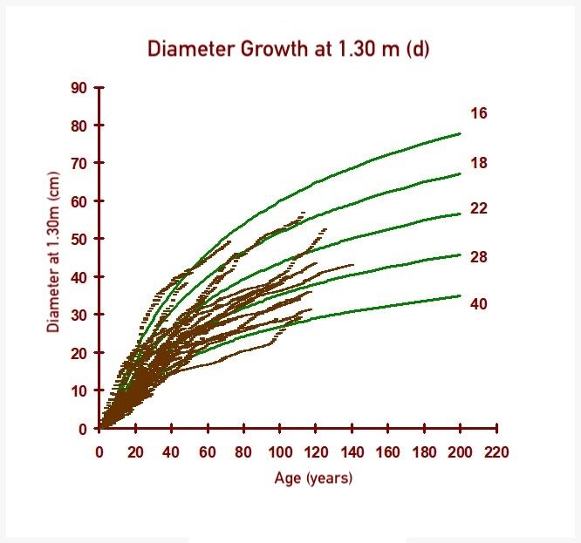
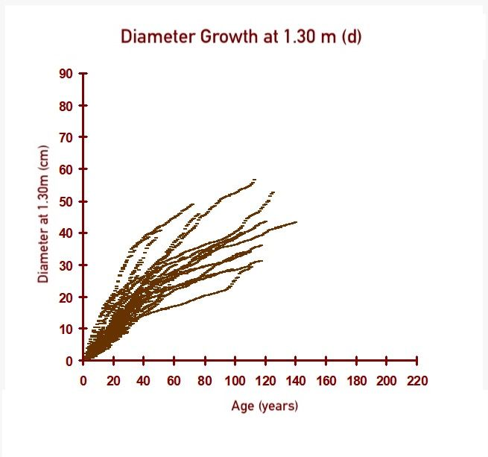
StandsSIM.md simflor.online SUBER Model – cork oak
Modelling options:
Diameter growth
Each stage of development is characterized by a set of equations/algorithms also called sub-models:
Stem analysis data used
  Diameter growth
  Prediction:
            - tree height,
        - diameter overbark
        - stem height
        - number of branches
        - crown diameter
  Cork growth
  Prediction cork weight by cork caliber x quality over the consecutive debarkings

Slide 4
StandsSIM.md simflor.online SUBER Model – cork oak
Stand at age t
Inicialialization
Complets forest inventory missing data
Growth
module to predict the growth of trees and cork
Predict mortality
Stand at age t+1
After thinning
t=t+1
Stand at age t+1
N
N
Debarking
?
Thin
Thinning
?
Y
Y
Stand at age t+1
After debarking
Debark
Predict cork weight

Slide 5



StandsSIM.md simflor.online SUBER Model – cork oak
Evolution of the stand driven by management
Stand Characteristics
Silvicultural operations caledar definition
Forest management approaches (FMA)

Slide 6
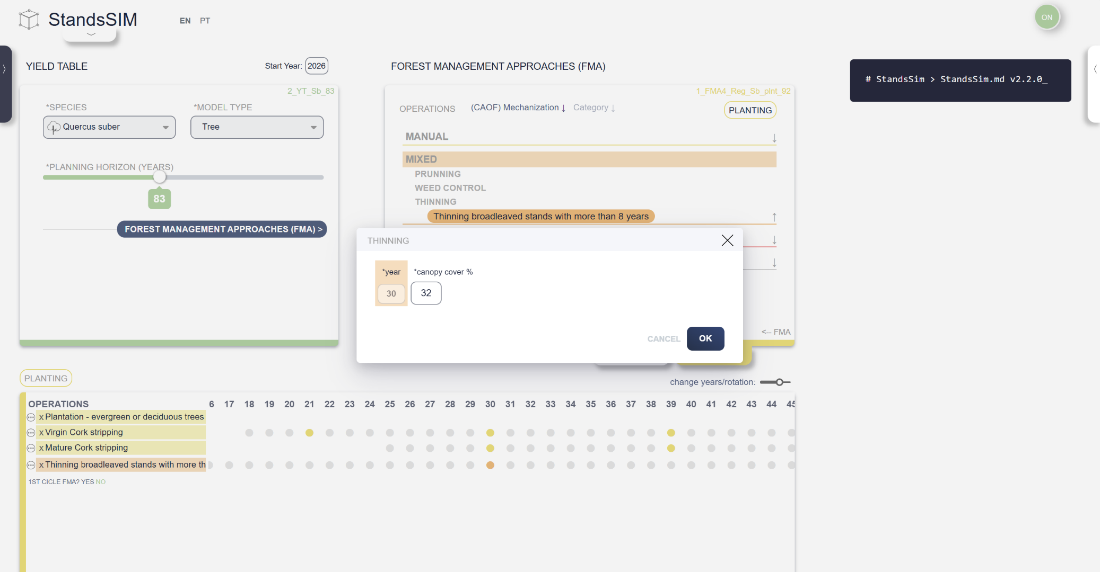
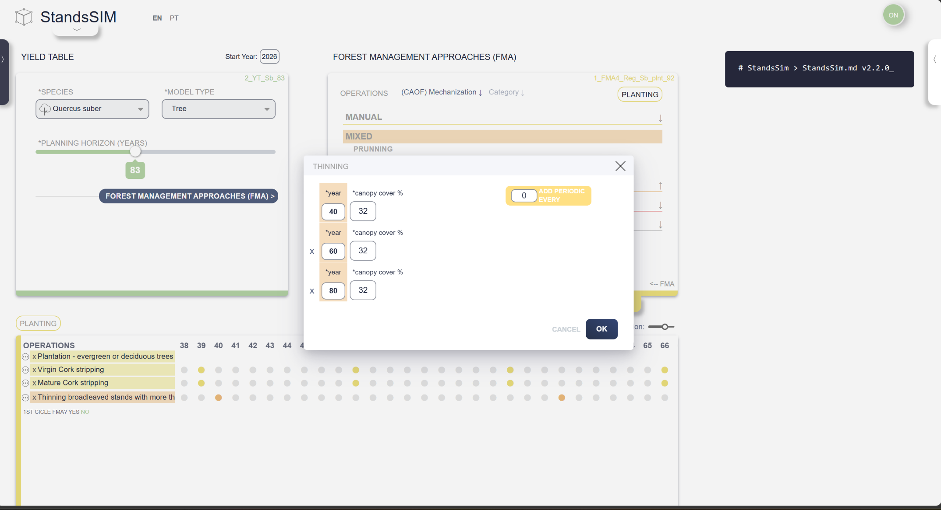
StandsSIM.md simflor.online SUBER Model – cork oak
Forest management alternatives:
Thinning (%CC)

Slide 7
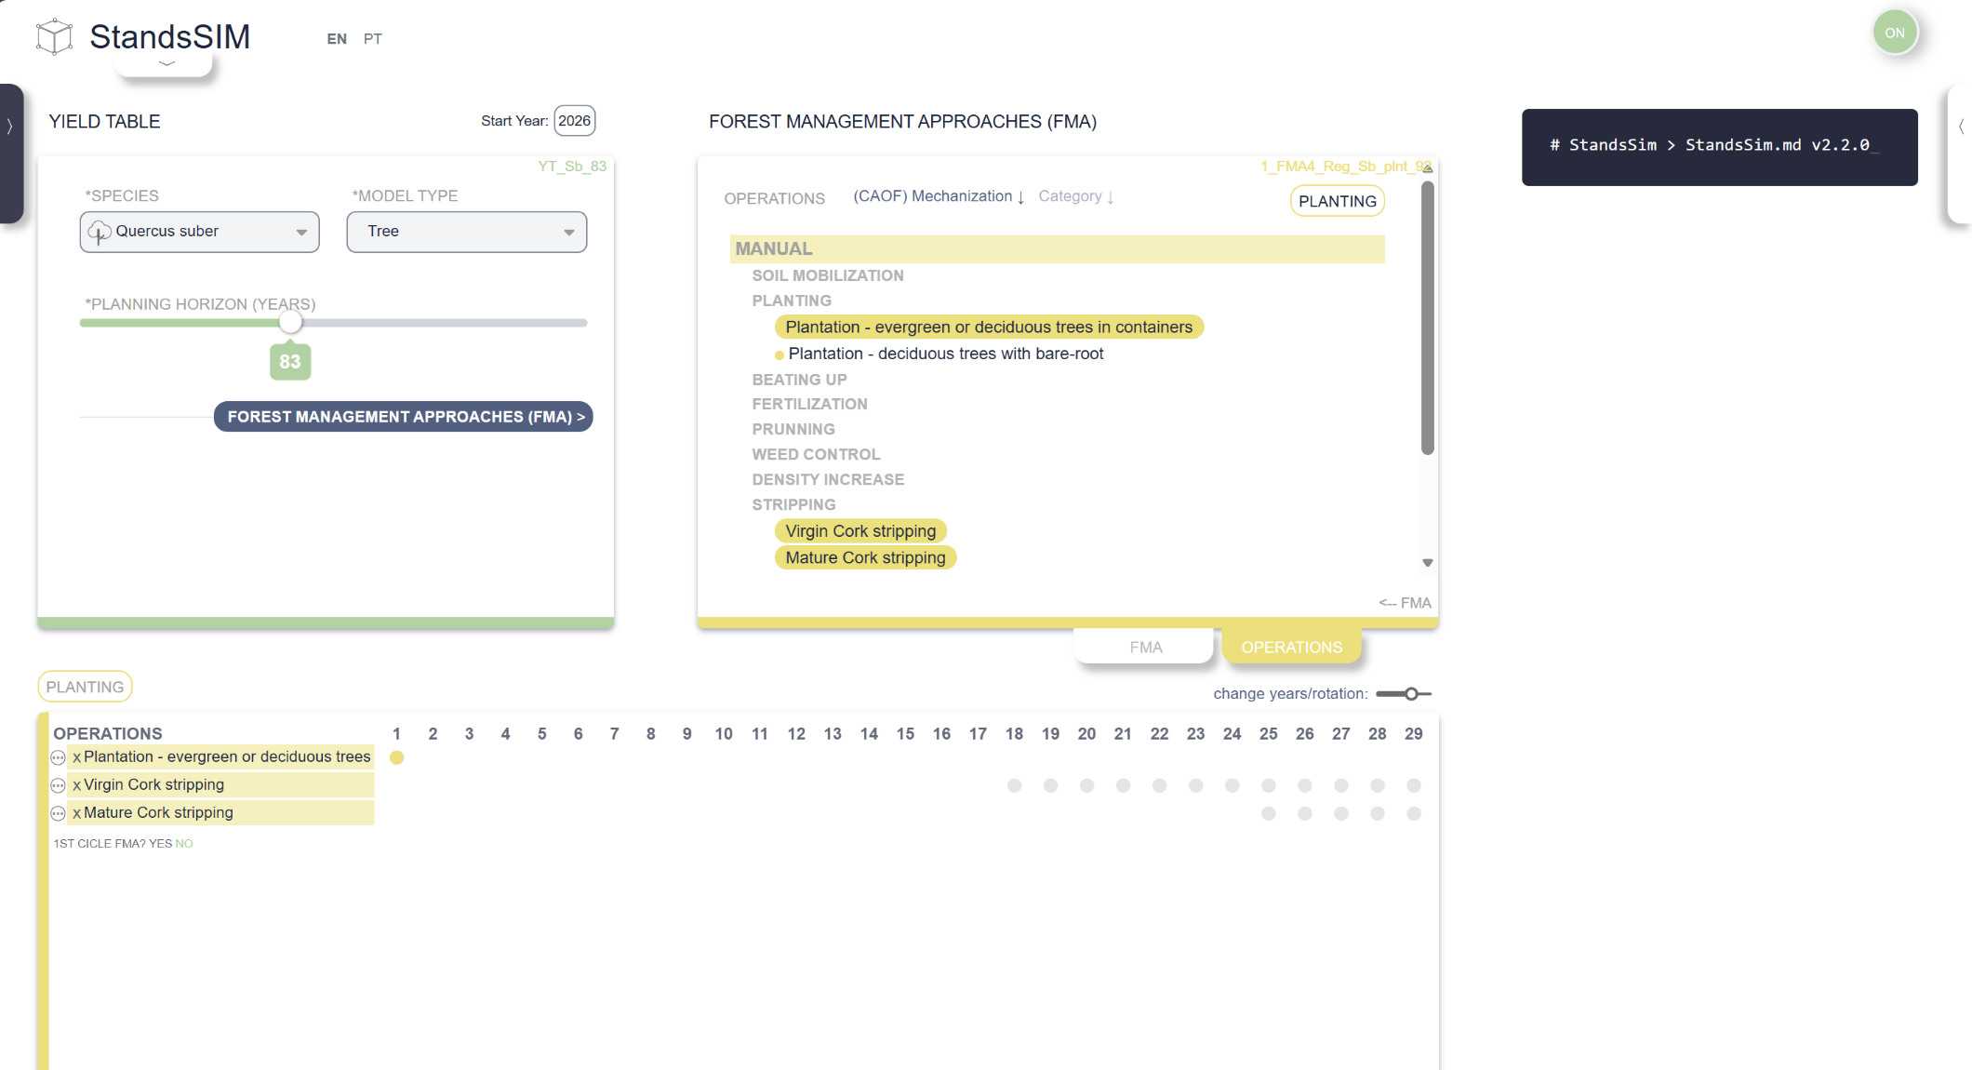
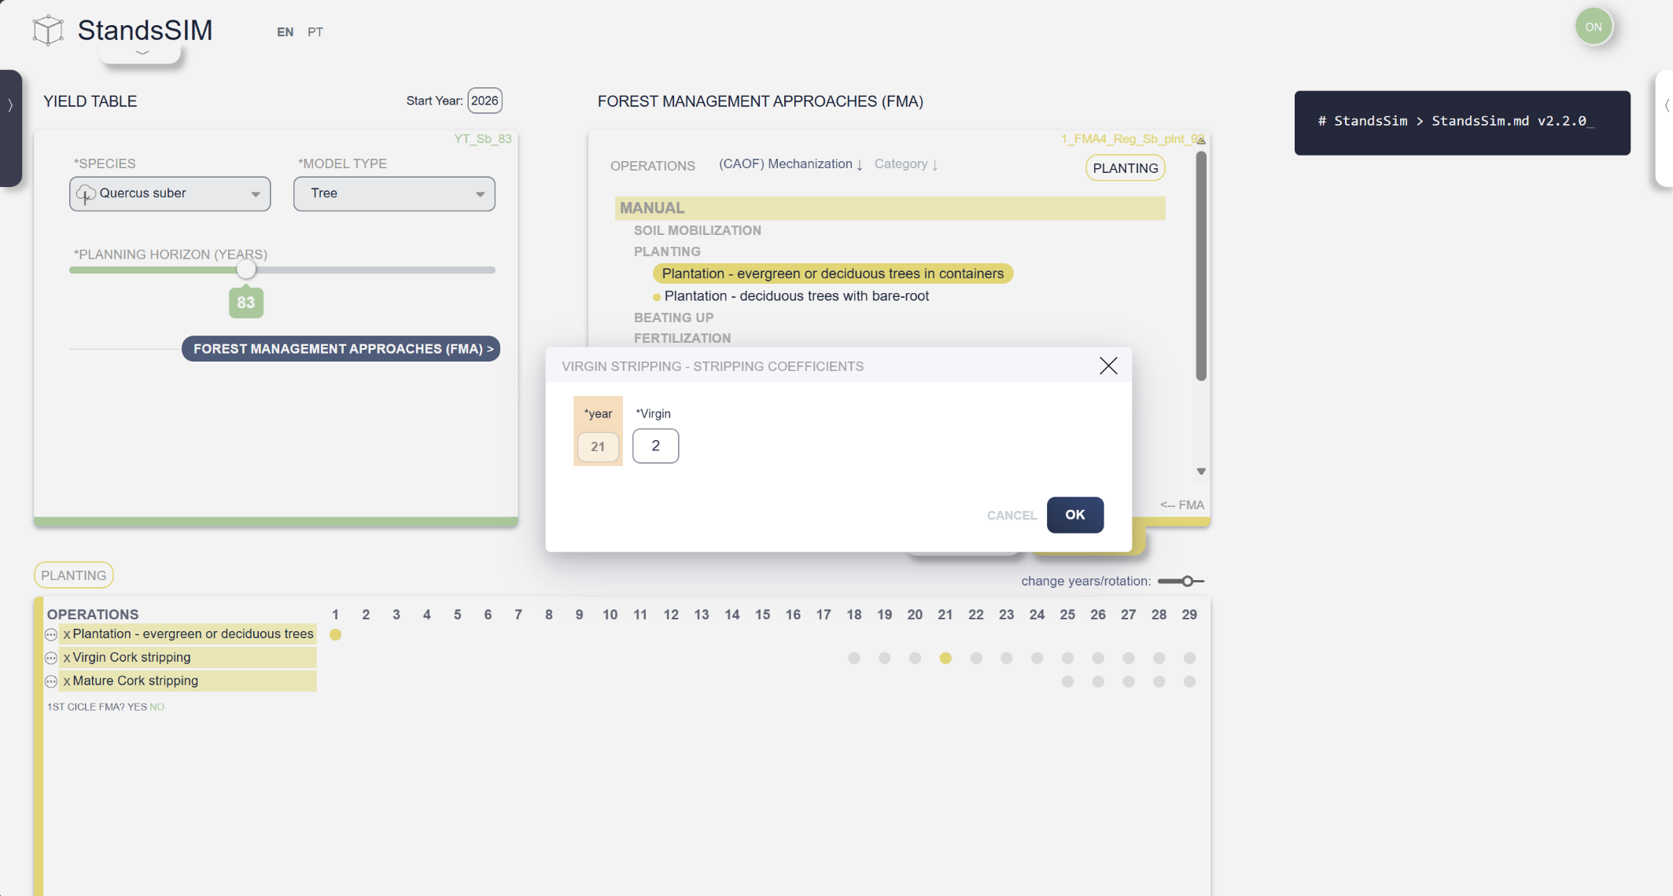
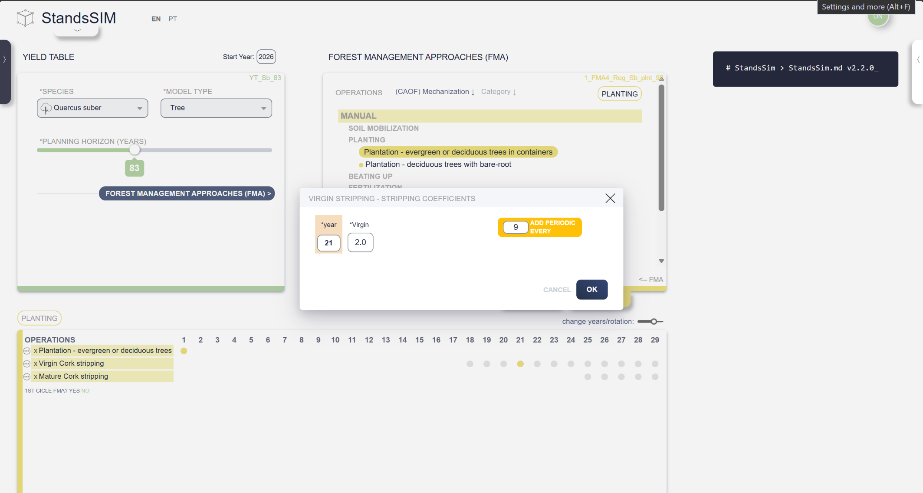
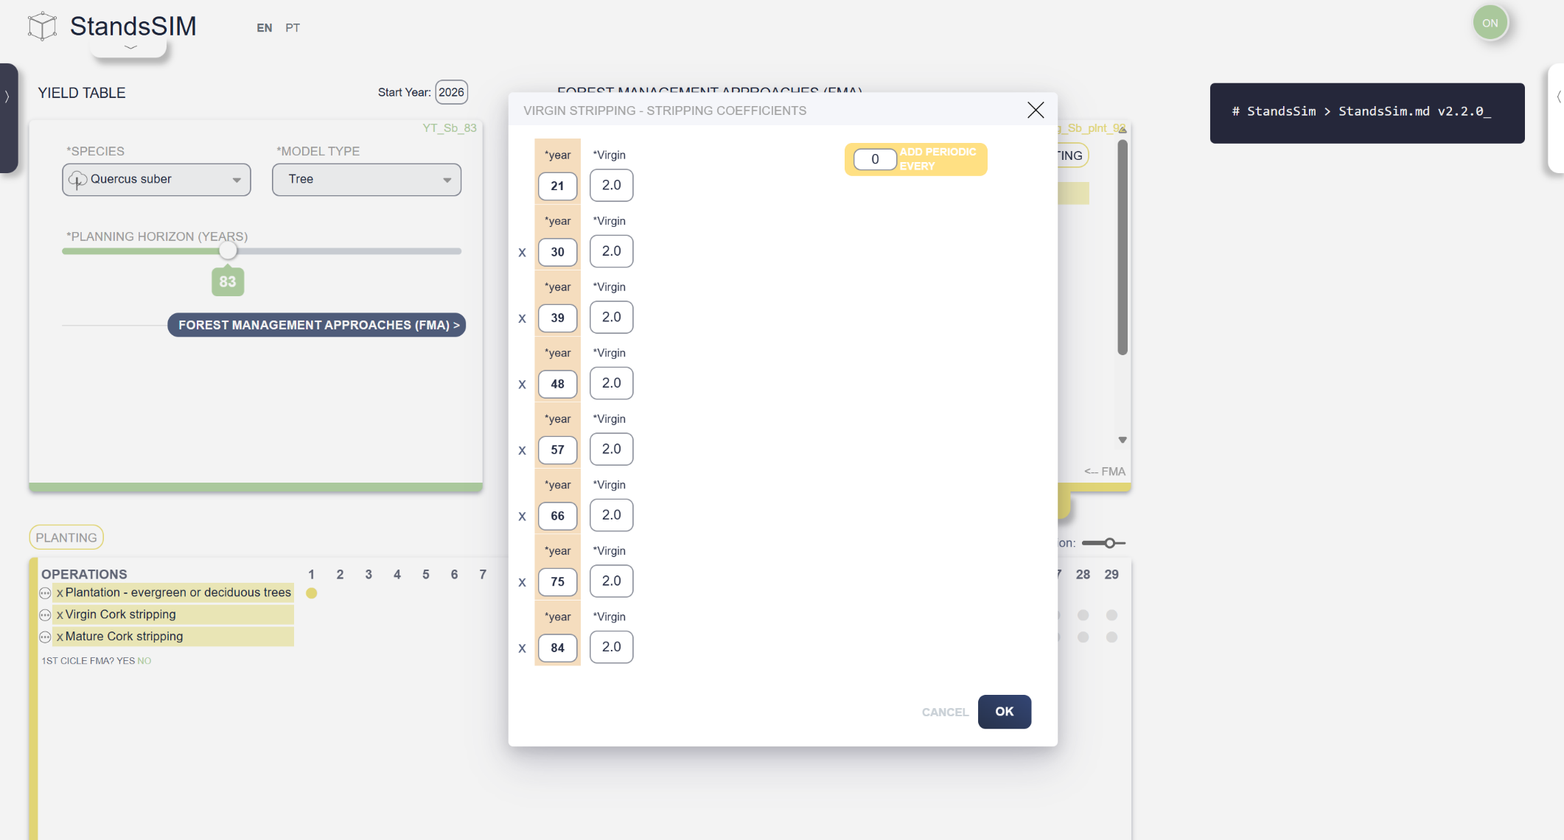
StandsSIM.md simflor.online SUBER Model – cork oak
Forest management alternatives:
Stripping/debarking coefficient (not considered for the cork growth index)
1st debarking (“desbóia“, ~ 18 - 25 yrs) :
  Minimum perimeter overbark at 1.30 m ->= 70 cm
  And debarking height = 1.4 m
  => Virgen cork (coef_debarking <= 2) -> coef_debarking = 140cm/70cm = 2

Slide 8

StandsSIM.md simflor.online SUBER Model – cork oak
Forest management alternatives:
Stripping/debarking coefficient (not considered for the cork growth index)
2nd debarking - cork (~ 30 - 35 yrs) :
  Second cork -> coef_debarking <= 2.5
  h_debark max = 2.5 x perimeter(dbh)

Slide 9
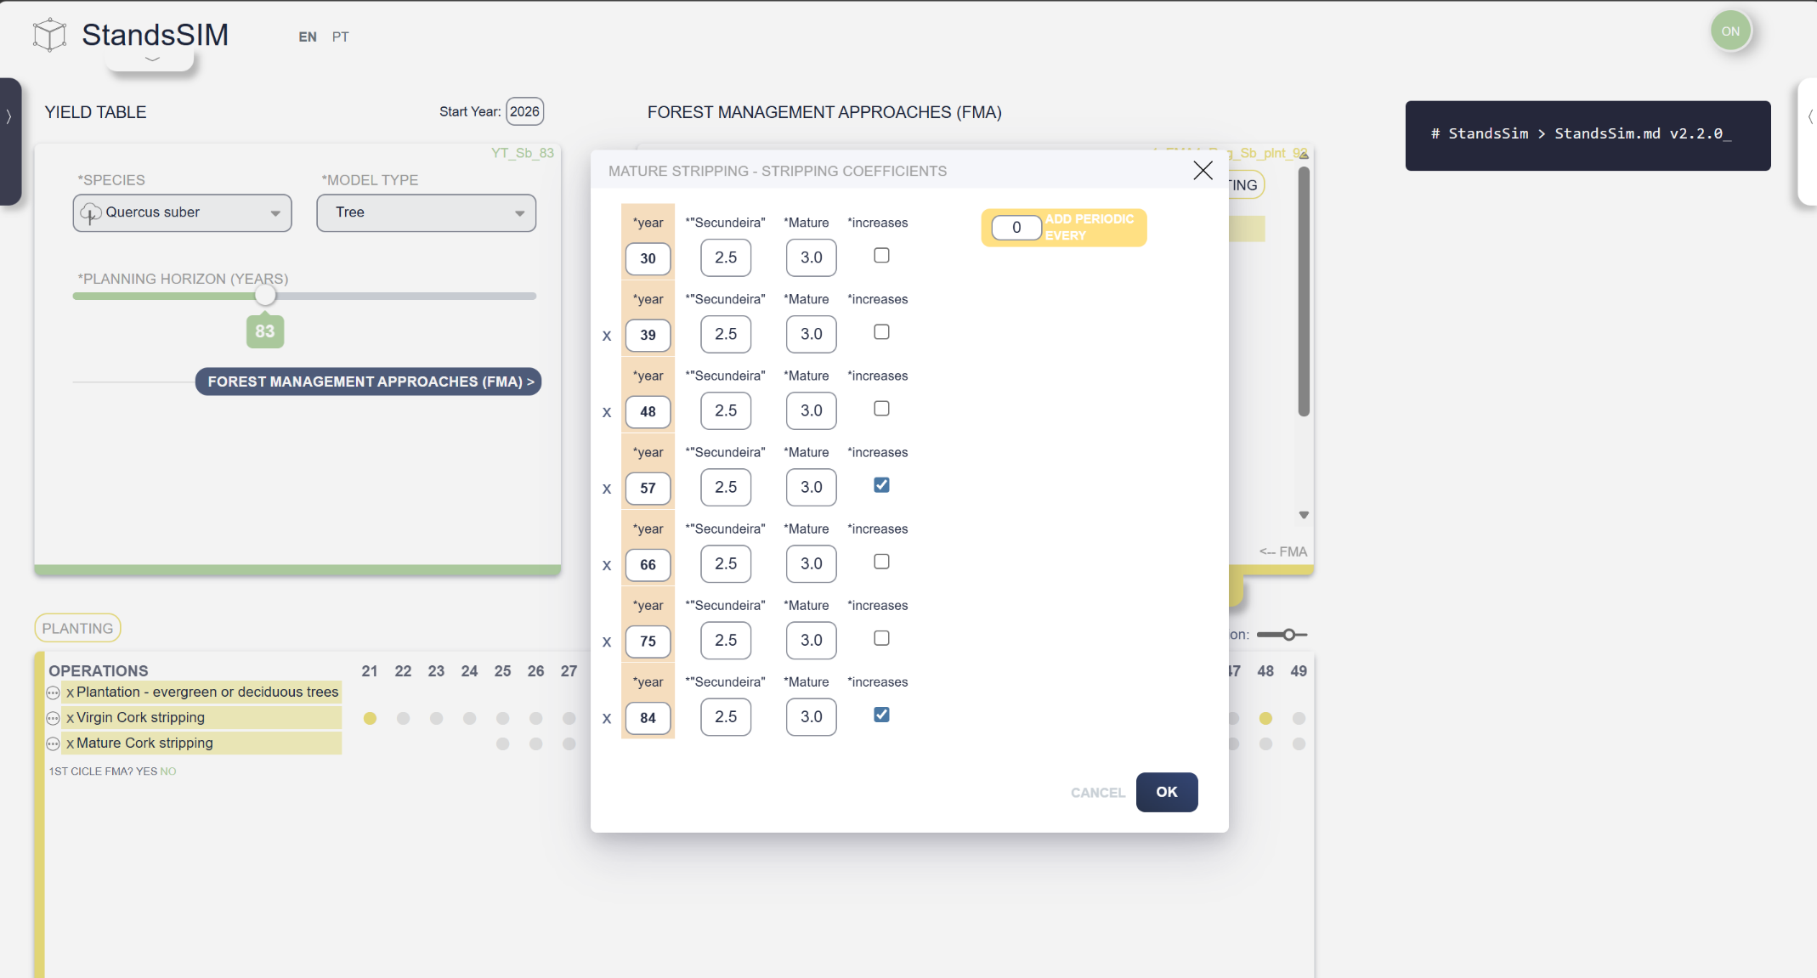
StandsSIM.md simflor.online SUBER Model – cork oak
Forest management alternatives:
Stripping/debarking coefficient (not considered for the cork growth index)
2nd debarking - cork (~ 30 - 35 yrs) :
  Second cork -> coef_debarking <= 2.5
  h_debark max = 2.5 x perimeter(dbh)
>2nd debarking - cork (~ 40 - 150 yrs)
      Mature cork -> coef_debarking <= 3
  h_debark max = 3 x perimeter(dbh)

Slide 10
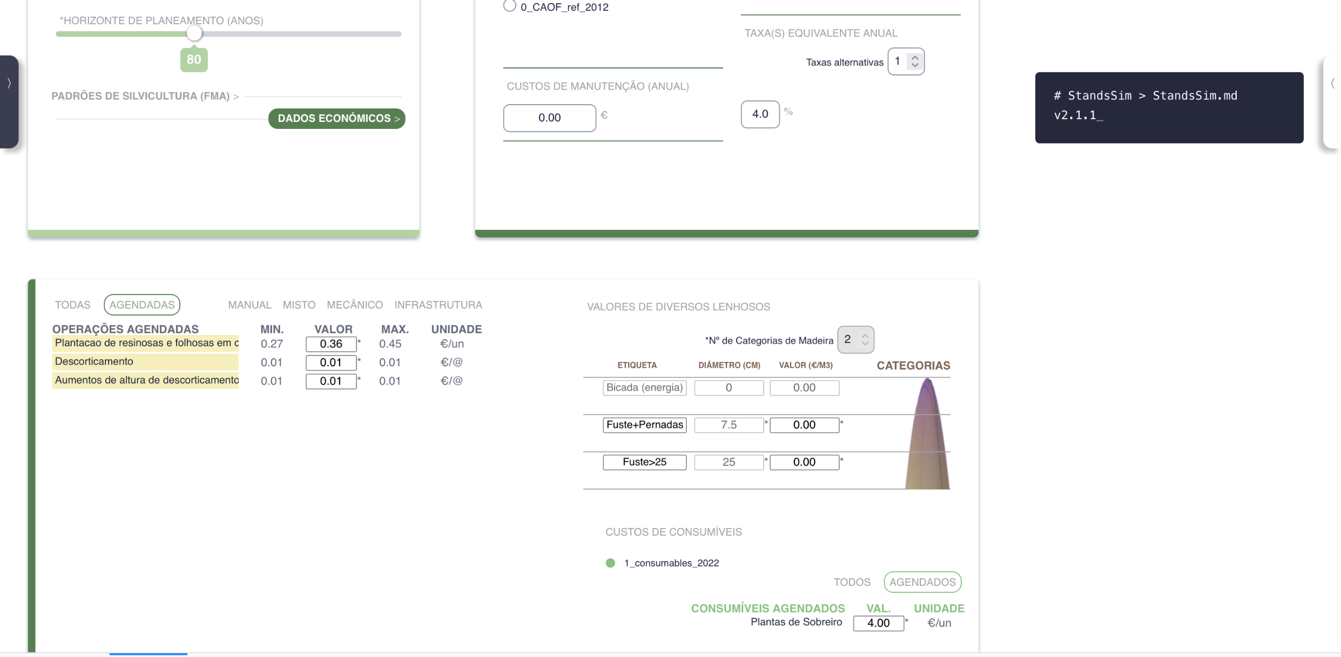
StandsSIM.md simflor.online SUBER Model – cork oak
Assortments:
SUBER v5.5 uses 2 fixed categories, with fixed diameters:
1st category (stem + branches): d > 7.5 cm no dap
2nd category (stem): d > 25 cm

Slide 11
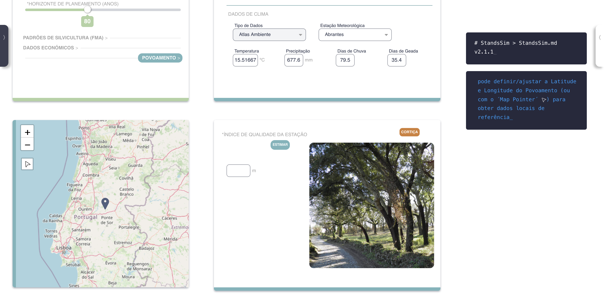
StandsSIM.md simflor.online SUBER Model – cork oak
Site quality estimation(S):
Three alternative models are available to estimate Site Index, all of them depend on the location of the Stand:

Slide 12
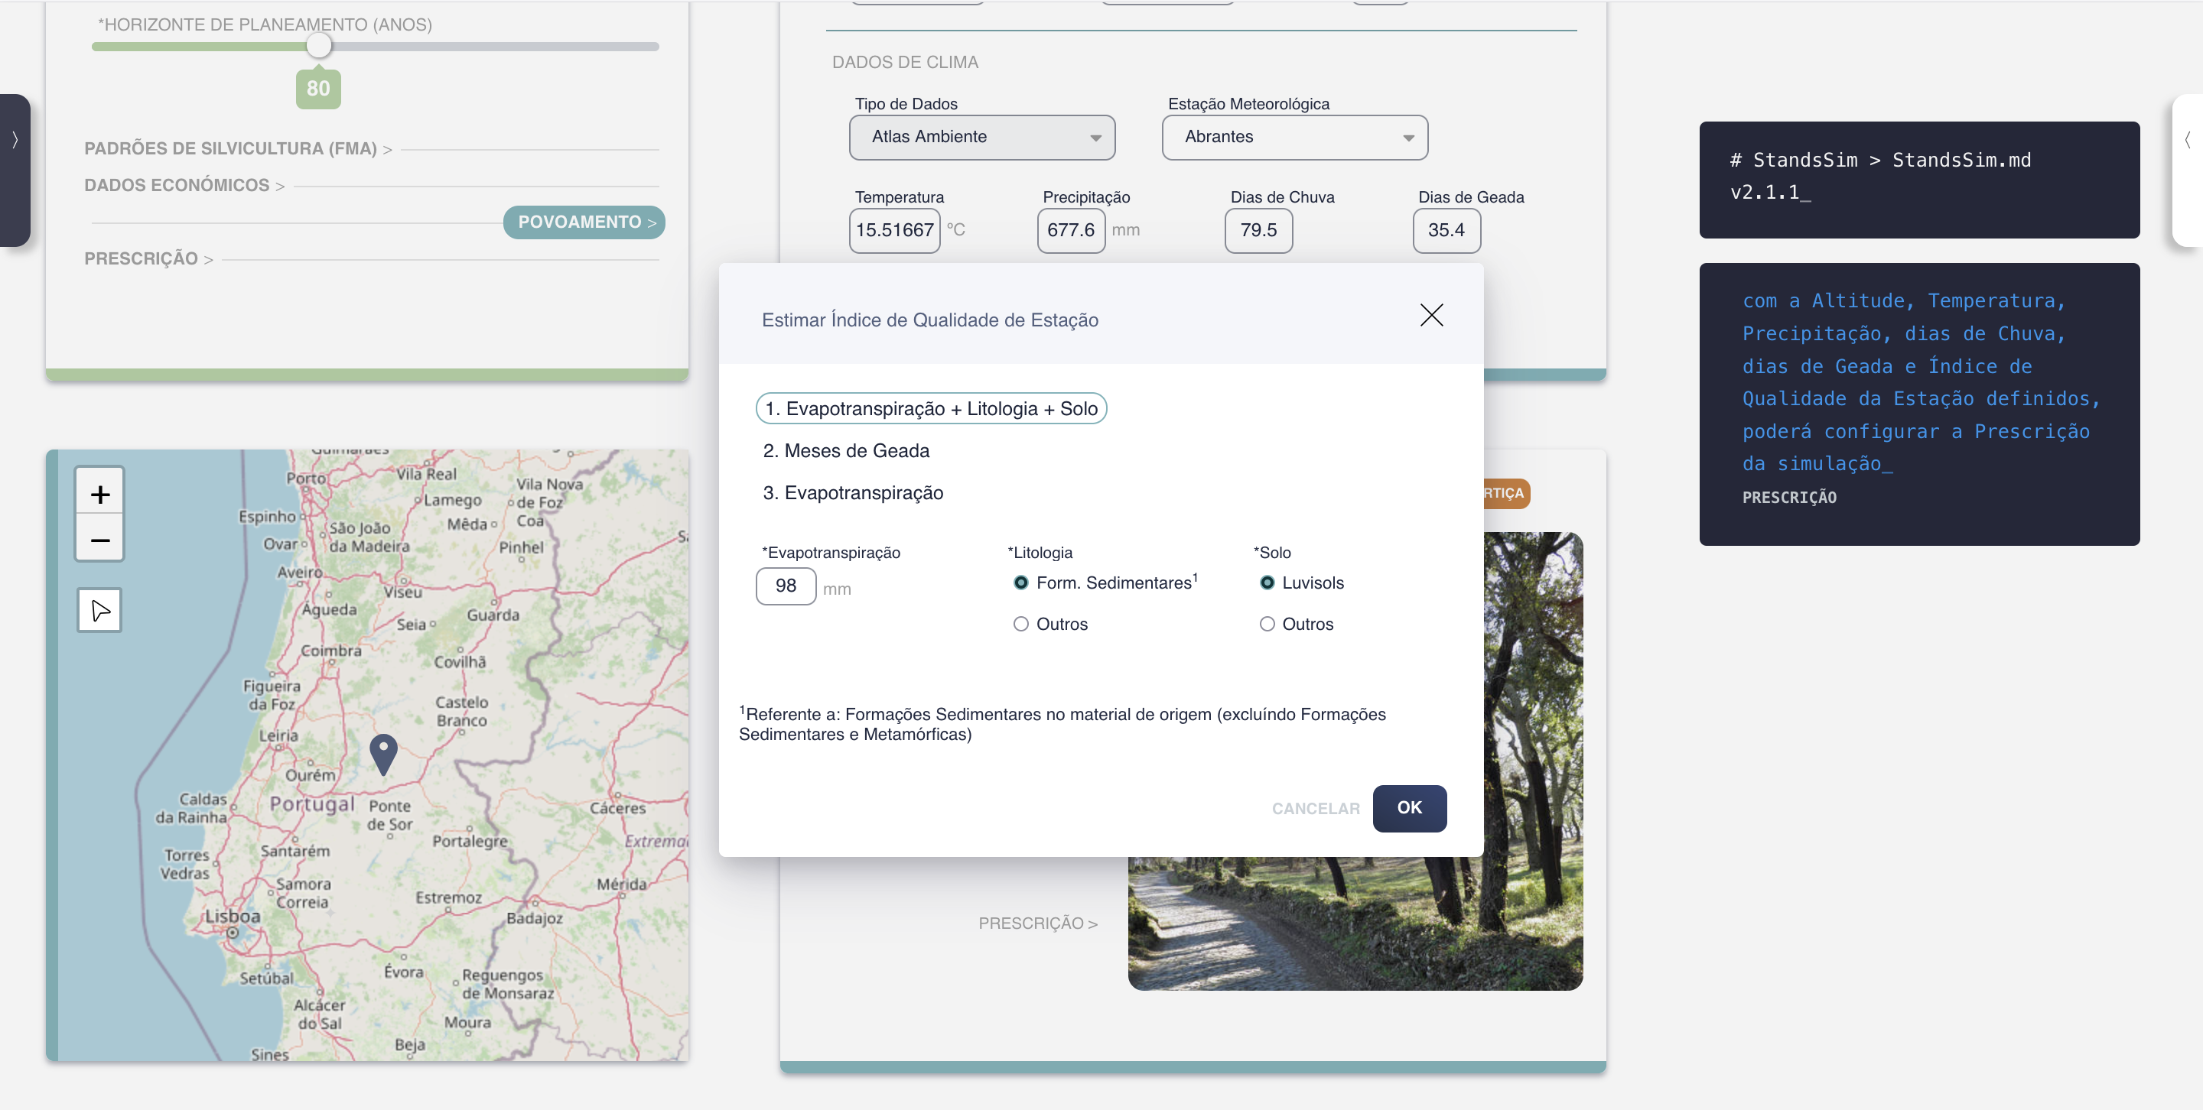
StandsSIM.md simflor.online SUBER Model – cork oak
The most recent one combines Soil information with Evapotranspiration
(own data, or defined by the location in Atlas do Ambiente)
Estimadores de Índice de Qualidade da Estação (S):
São disponibilizados três modelos para estimar o Site Index, que dependem da localização do povoamento definida:
Using “Using months with frost”
or
using “Evapotranspiration”
(own data, or defined by the location in Atlas do Ambiente)

Slide 13
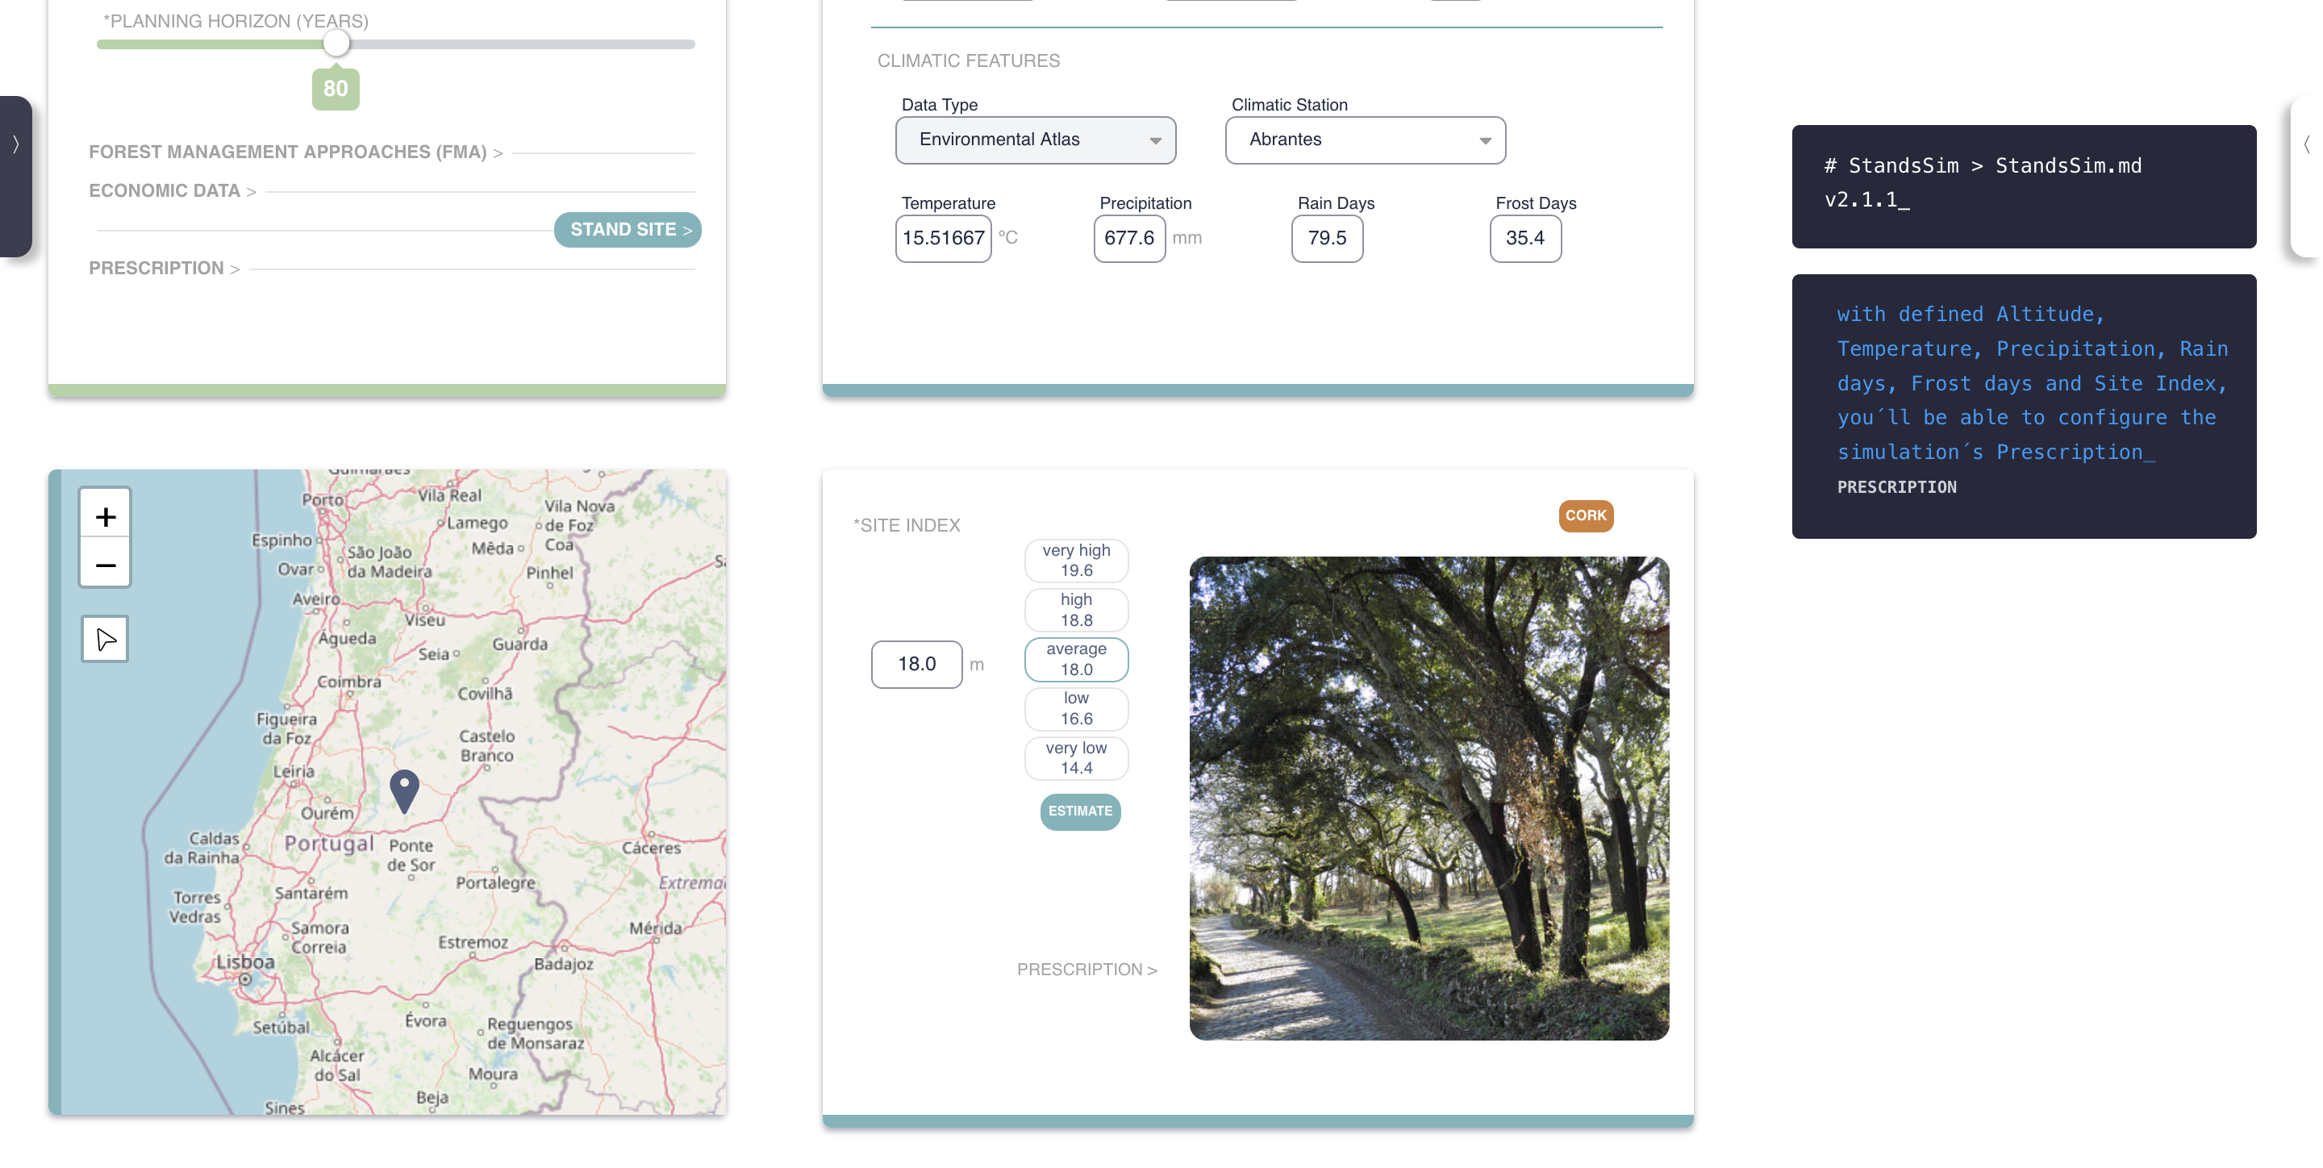
StandsSIM.md simflor.online SUBER Model – cork oak
O mais recente, que concilia dados do Solo com Evapotranspiração
(dados próprios, ou definidos para o local no Atlas do Ambiente)
Estimadores de Índice de Qualidade da Estação (S):
São disponibilizados três modelos para estimar o Site Index, que dependem da localização do povoamento definida:
com “Meses de Geada”
ou
com “Evapotranspiração”
(dados próprios, ou definidos para o local no Atlas do Ambiente)

Slide 14
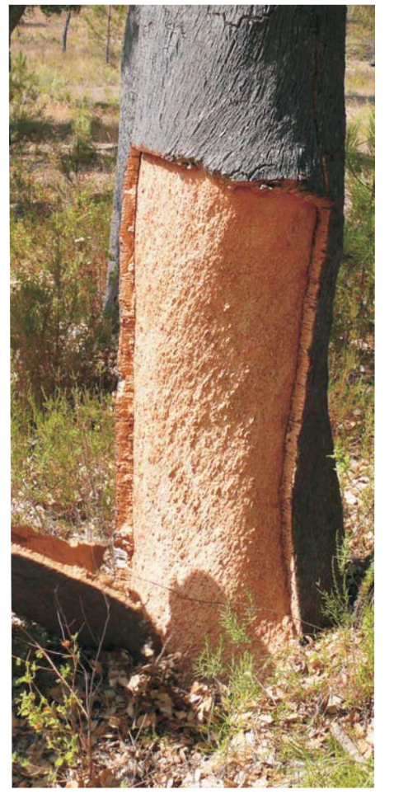
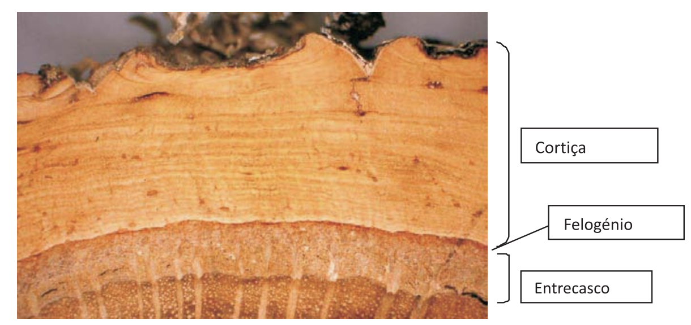
StandsSIM.md simflor.online SUBER Model – cork oak
Cork characterization:
It is based on 4 distributions built for:
- the tree variables stem height (hs) and number of debarked branches (nbr)
- cork caliber and cork quality
In the simulations these distributions are also used to define cork comercial classes
Cork
Phelogene
Inner-bark

Slide 15
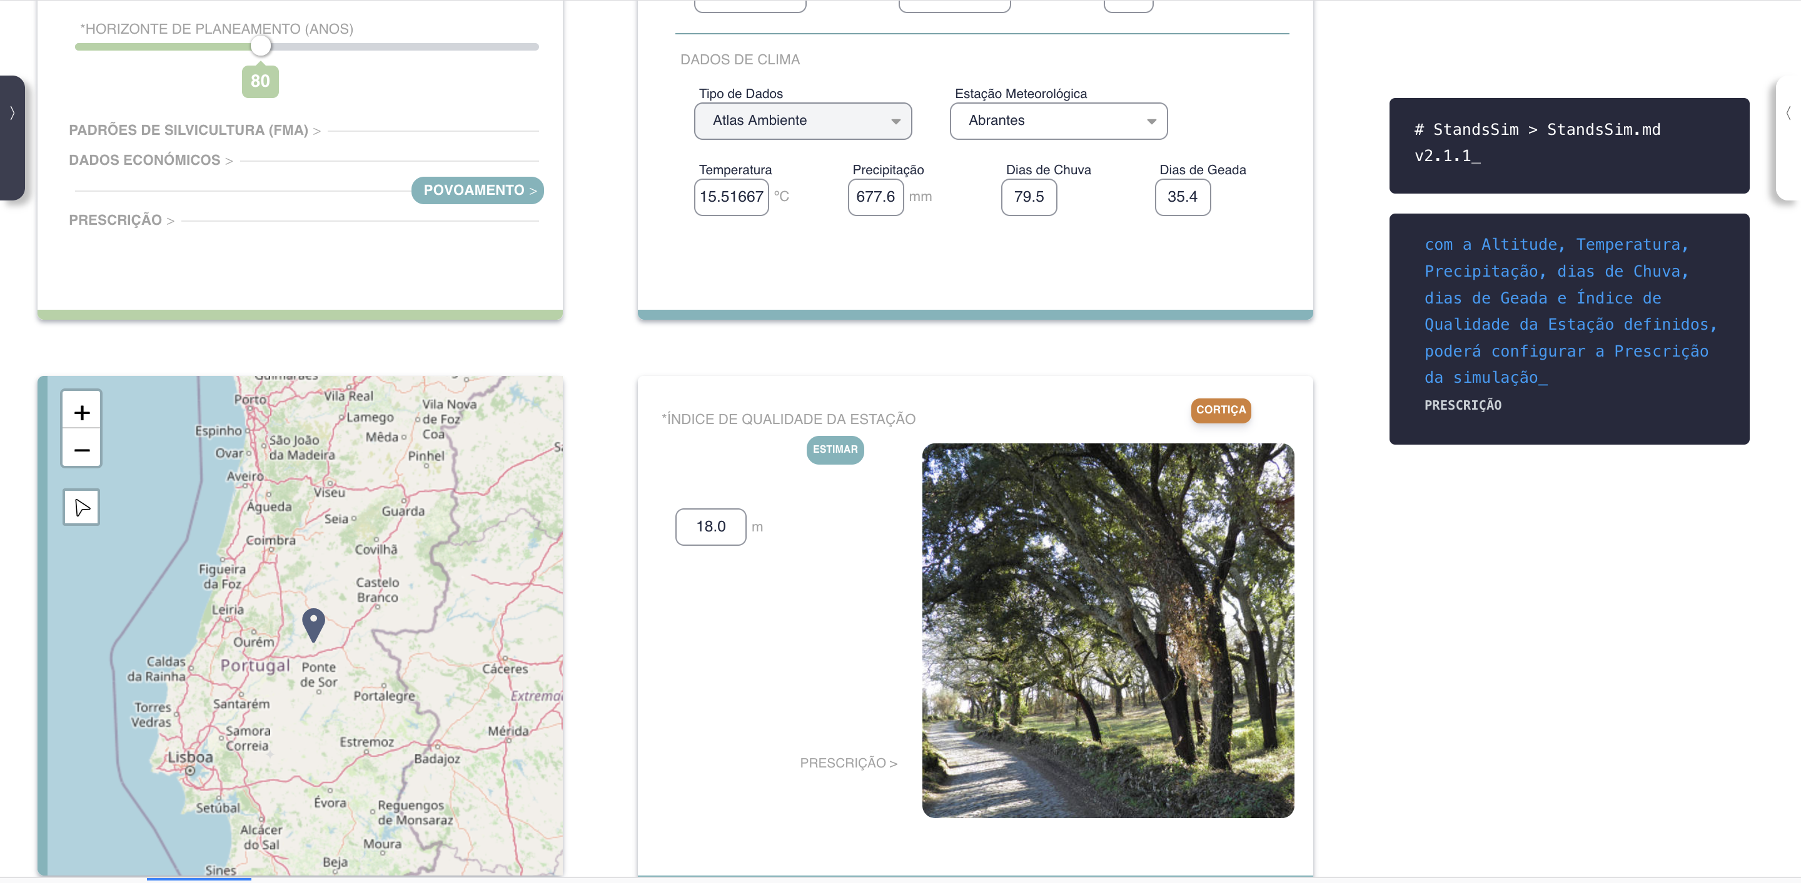
StandsSIM.md simflor.online SUBER Model – cork oak
Cork characterization:

Slide 16
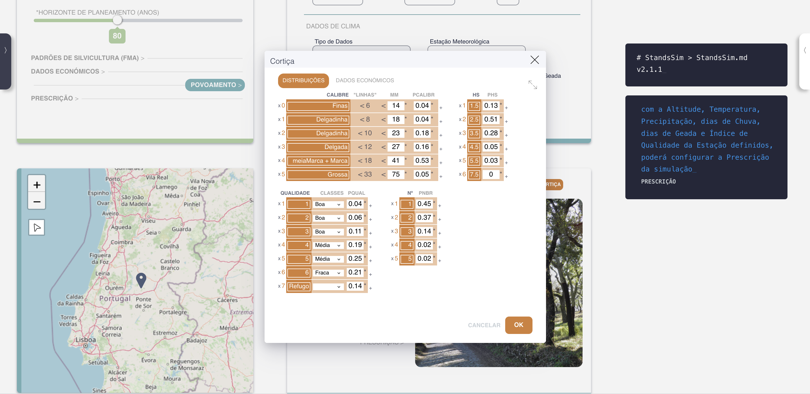
StandsSIM.md simflor.online SUBER Model – cork oak
Cork characterization:
Number of debarked branches
Proportion of trees with 1, 2, 3, 4, or 5 branches per tree
(based on field inventory or in the distribution built for the choosen region where the stand is located)

Slide 17
StandsSIM.md simflor.online SUBER Model – cork oak
Cork characterization:
Stem height
Proportion of trees with stem heights up to 1.5, between 1.5 and 2.5, between 2.5 and 3.5, …, between 5.5 and 7.5
(based on field inventory or in the distribution built for the choosen region where the stand is located)

Slide 18
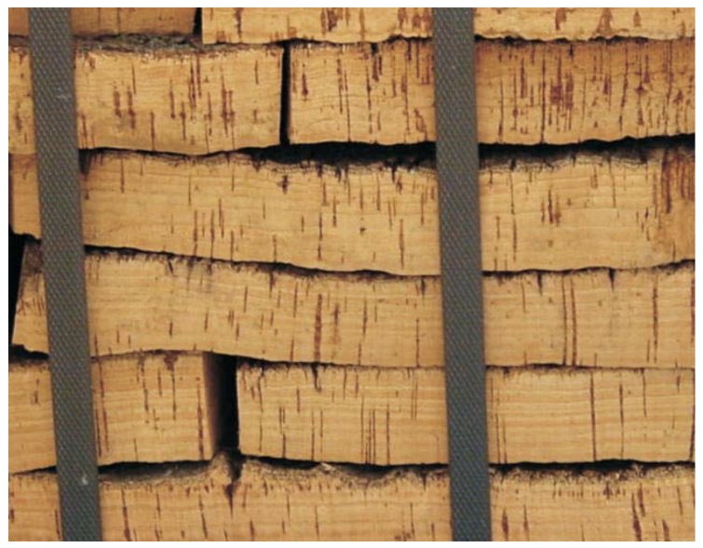
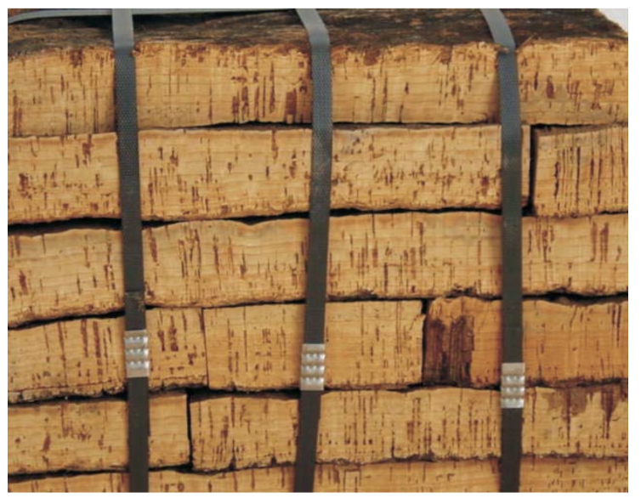
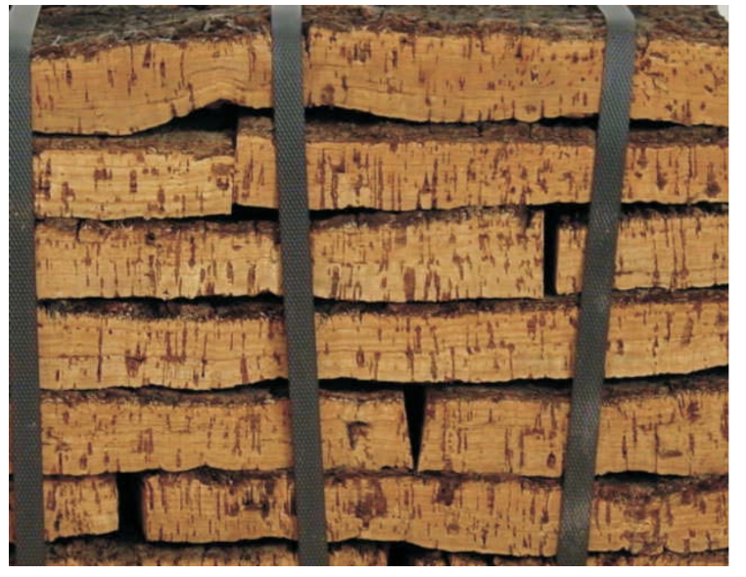
StandsSIM.md simflor.online SUBER Model – cork oak
Cork characterization:
Good quality
Average quality
Poor quality
Cork quality classes
Depend on the porosity degree and type of pores
(based on cork sample inventory [calas] or in the distribution built for the choosen region where the stand is located)

Slide 19
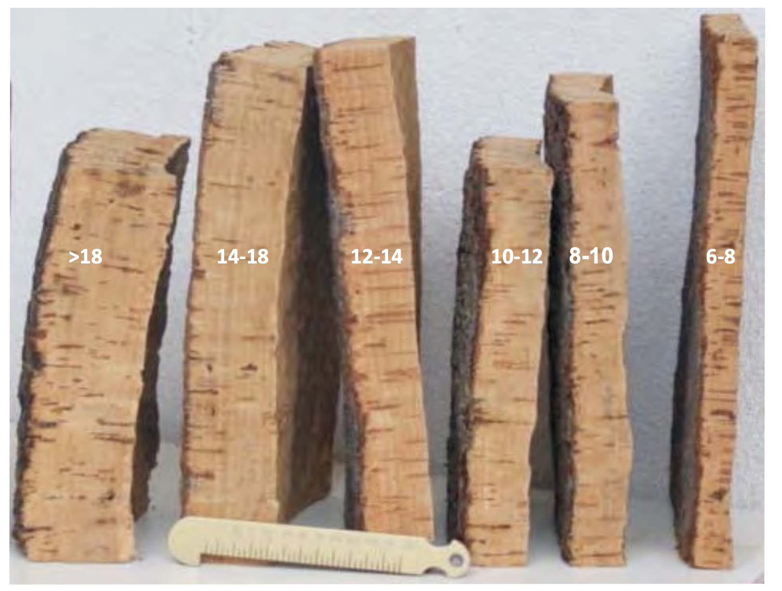
StandsSIM.md simflor.online SUBER Model – cork oak
Cork characterization:
Caliber classes
6 base classes (these may change in certain years /regions)
The caliber class is defined by the cork thickness (“linhas”/ mm)
The proportion of trees with cork of each caliber is defined by a “calas” inventory carried out in that stand or based on the distribution built for the choosen region where the stand is located)
Different cork calibers (and corresponding nr of “linhas”

Slide 20
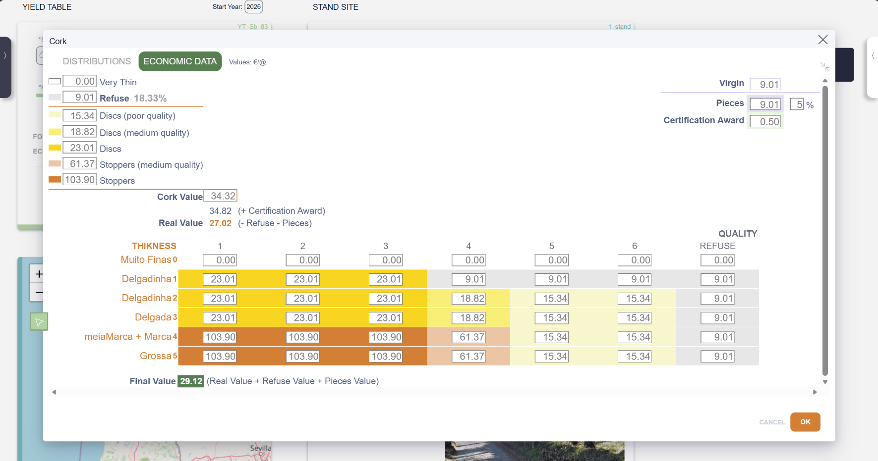
StandsSIM.md simflor.online SUBER Model – cork oak
Cork economic data:
Cork caliber and quality together define the cork comercial classes for which prices per @ (~15 kg) are defined
Unlike what happens for other forest products, because cork characterits thata affect its comercial value, cork economic data shows in the tab where the stand is characterized.
A comercial classes matrix is built based on cork caliber and quality.
The classes from “Refuse” to “Stoppers” are defined in blocks along the matrix easily identiaded by the colour scheme where each colour has a price in @ (~15kg).
Virgin cork and Refuse prices are defined outside the matrix (and usually have the same value). Likewise for the price of the Pieces and the certification award
The Cork Value (@) for the stand is calculated as a weighted average based on the quality and caliber distributions and the matrix values allowing also to estimate the Real Value and the Cork Final Value
Only user-defined information
If the process of each commercial class are know, these values can be edited and the table gets automatically updated

Slide 21
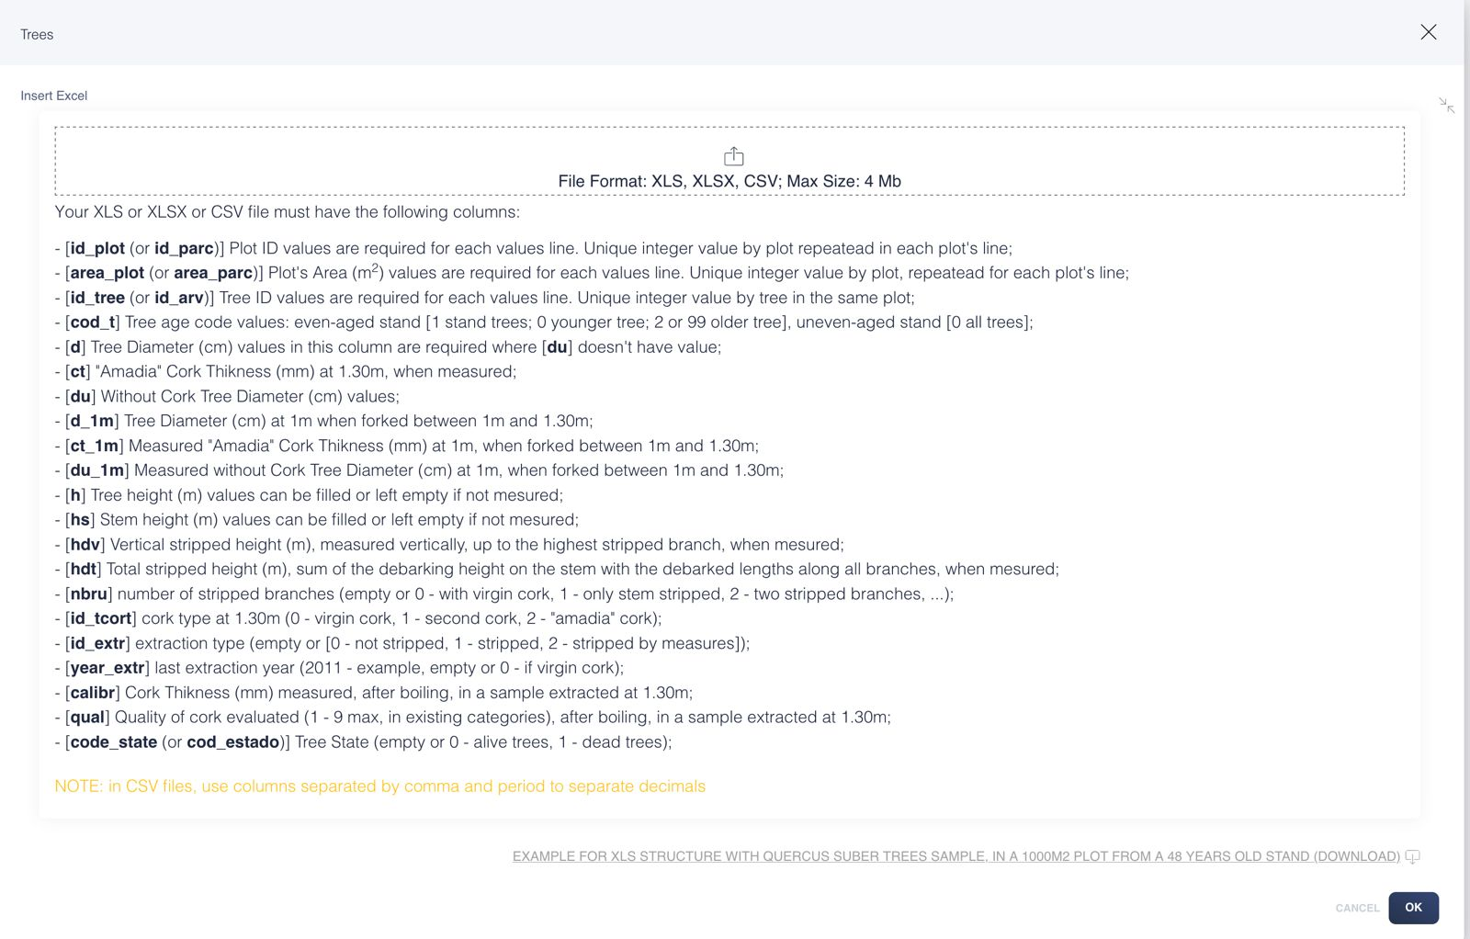
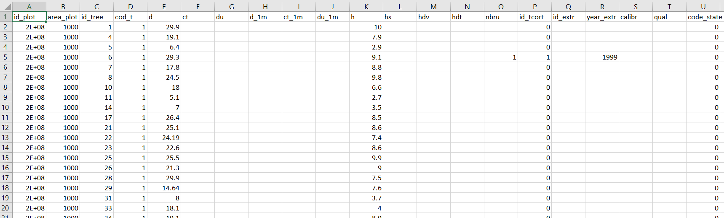
StandsSIM.md simflor.online SUBER Model – cork oak
Running an example: Use StandsSIM.md to simulate an existing stand for cork oak using the tree list default file made available in the simulator. (You have to download the file - Sb_R_48yrs_1000m2.xlsx to your computer before you can uploaded it to the simulator). The stand had a forest inventory before debarking in 1999.
Consider a planning horizon of 80yrs and the following FMAs:
a) Planting 400 trees ha-1 and debarking every 9 yrs starting at age 23
b) Planting 400 trees ha-1, debarking every 9 yrs starting at age 23, increasing debarking height at ages 66 and 75
Comment the differences.

Slide 22
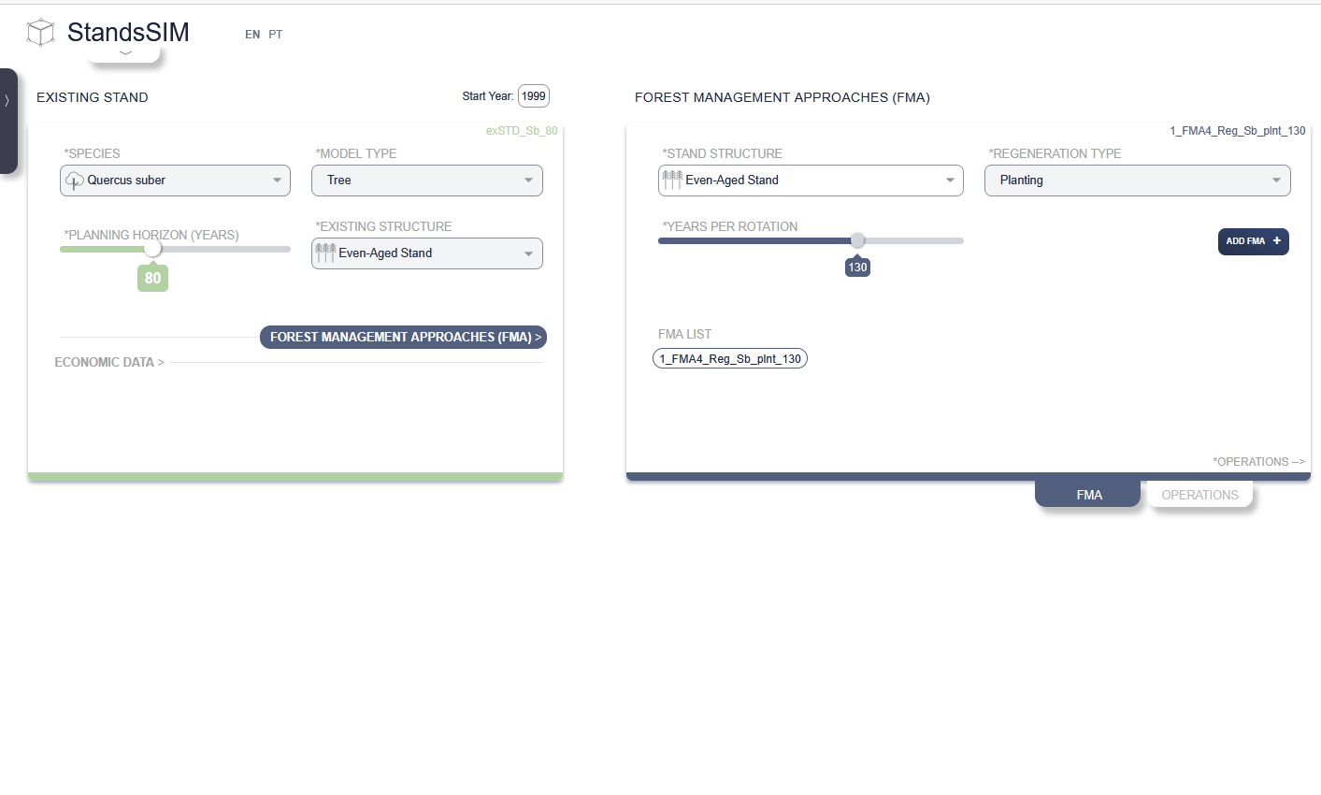
StandsSIM.md simflor.online SUBER Model – cork oak

Slide 23
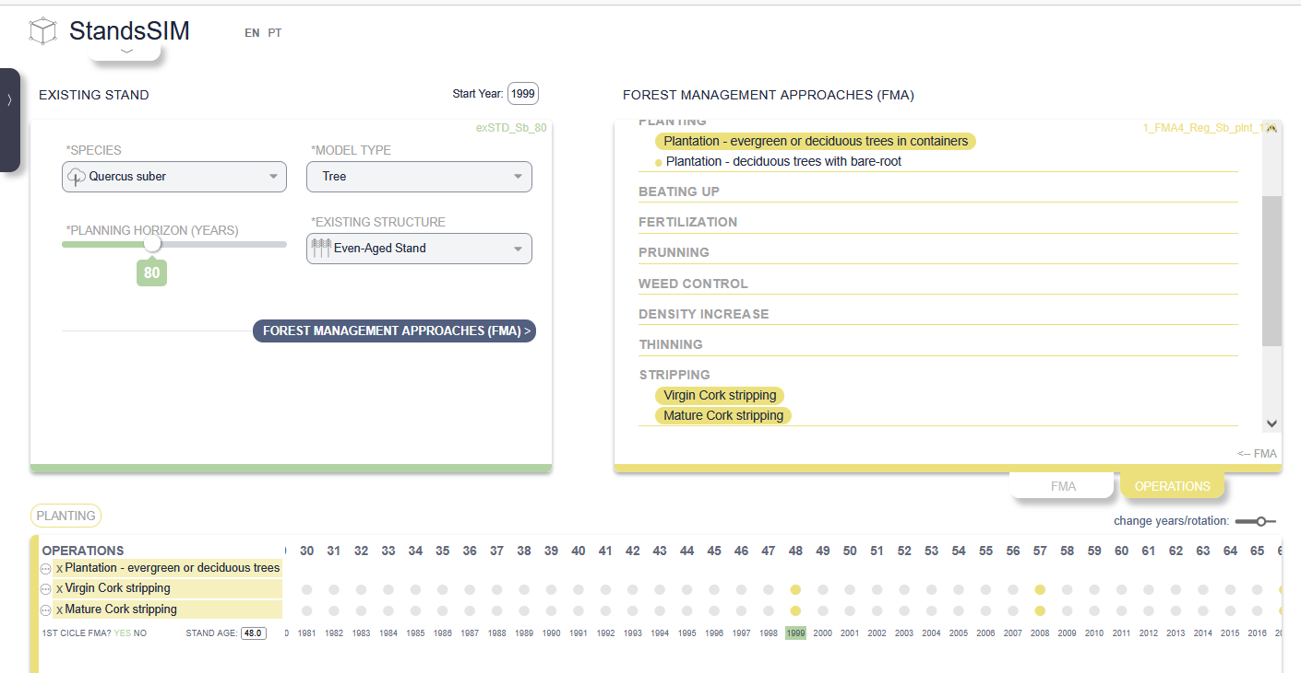
StandsSIM.md simflor.online SUBER Model – cork oak

Slide 24
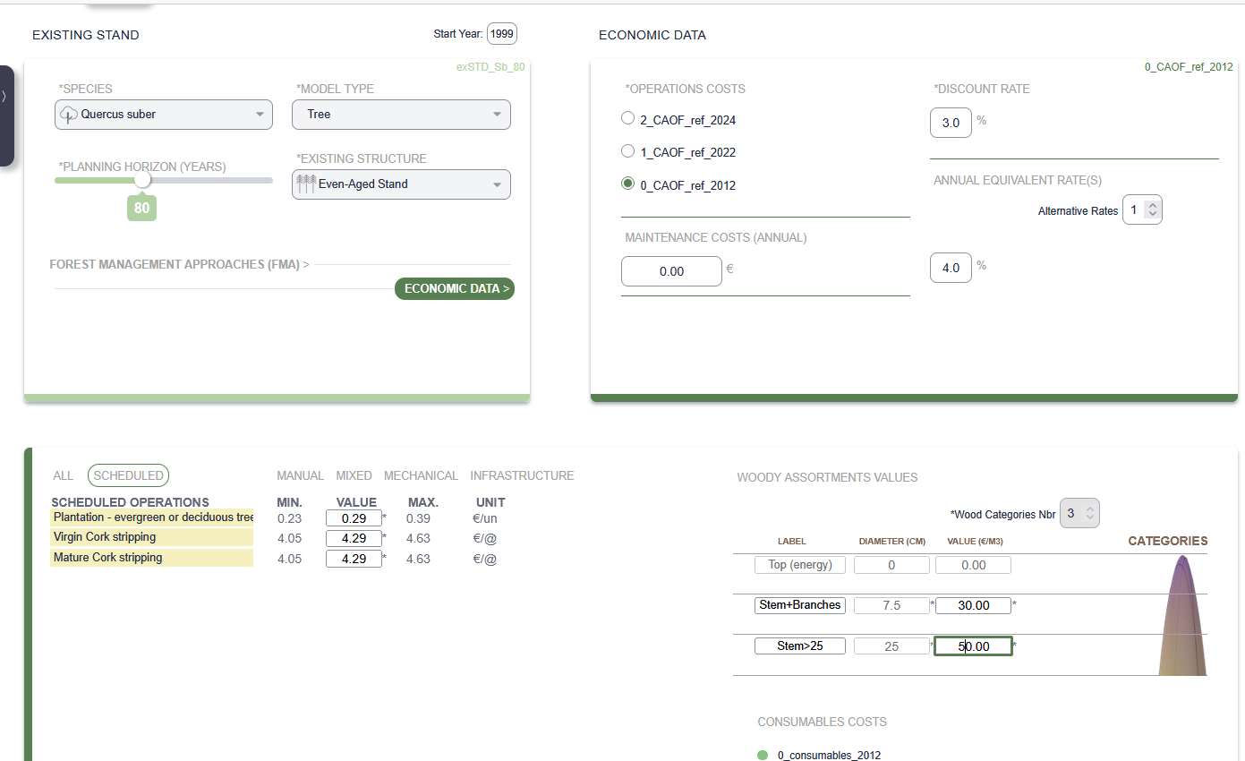
StandsSIM.md simflor.online SUBER Model – cork oak

Slide 25
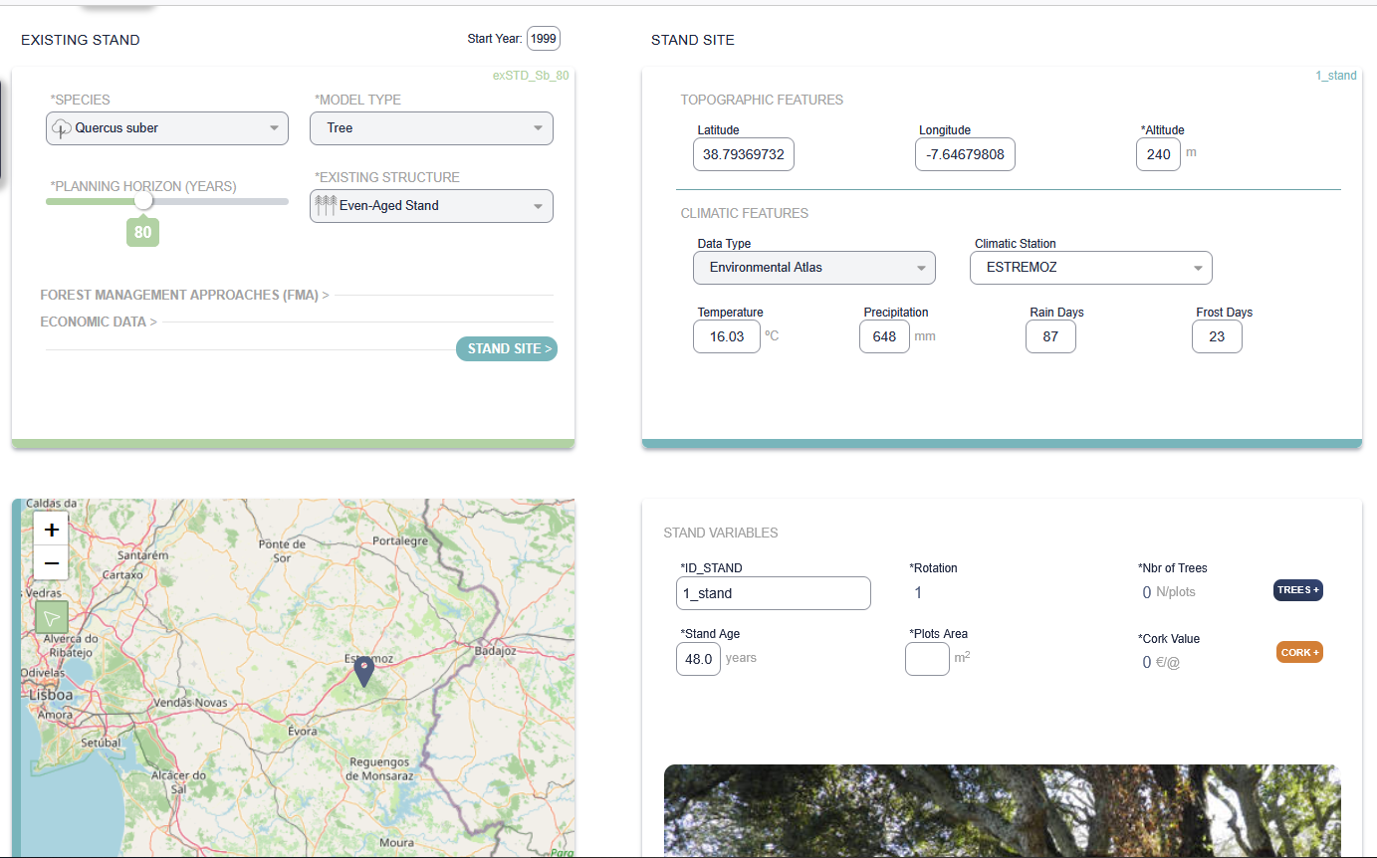
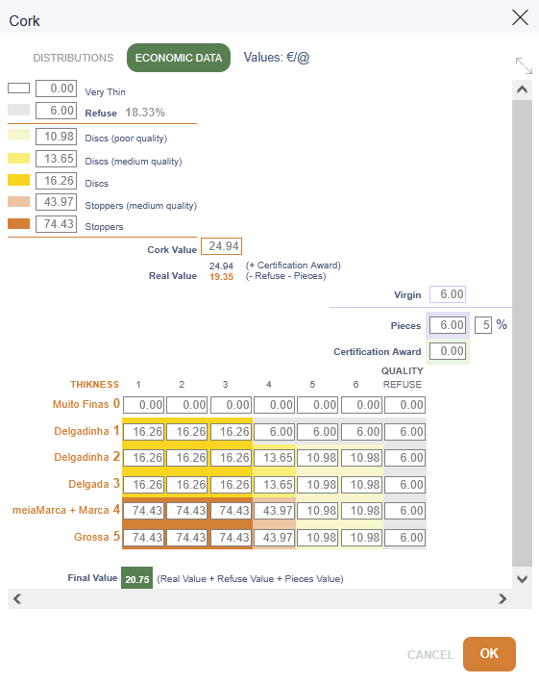
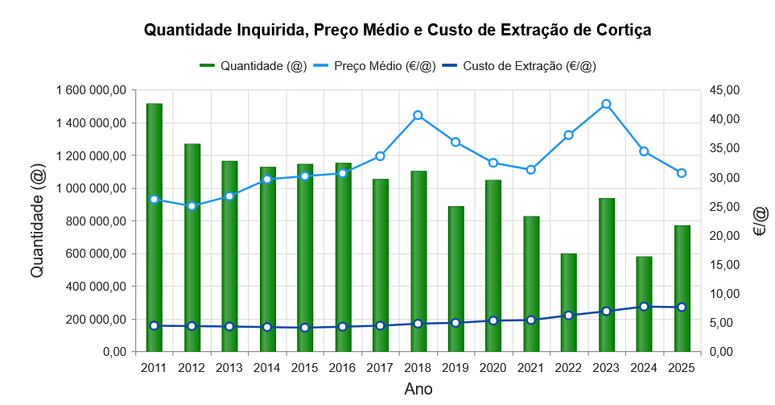
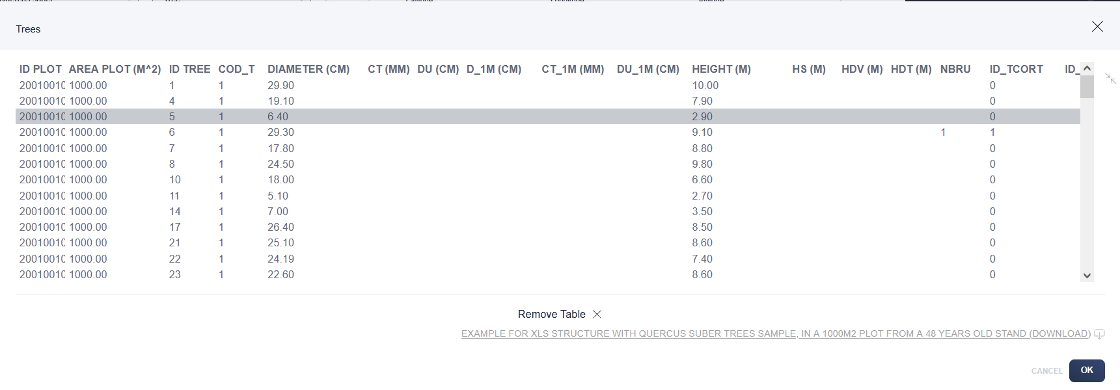
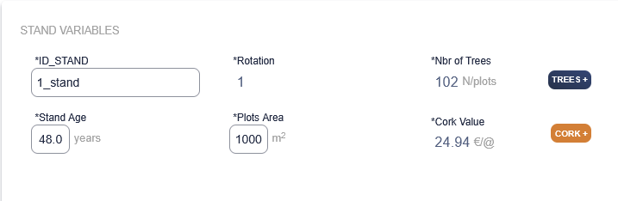
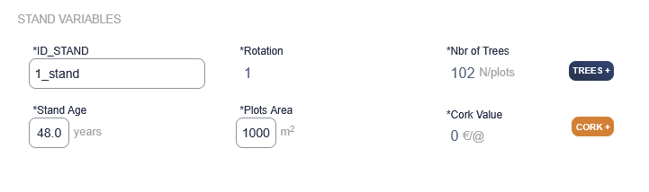
StandsSIM.md simflor.online SUBER Model – cork oak

Slide 26
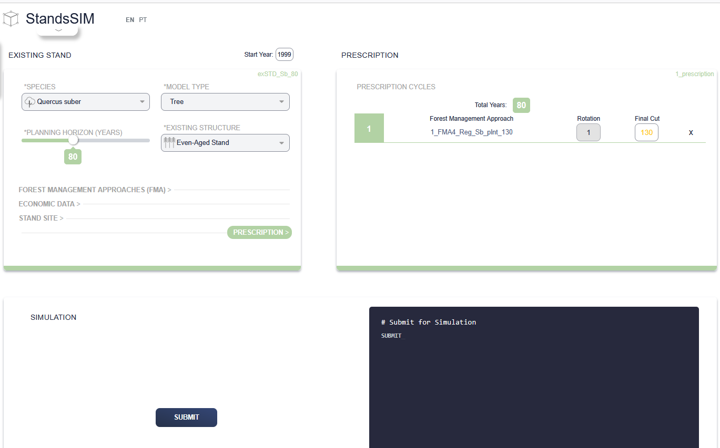
StandsSIM.md simflor.online SUBER Model – cork oak

Slide 27
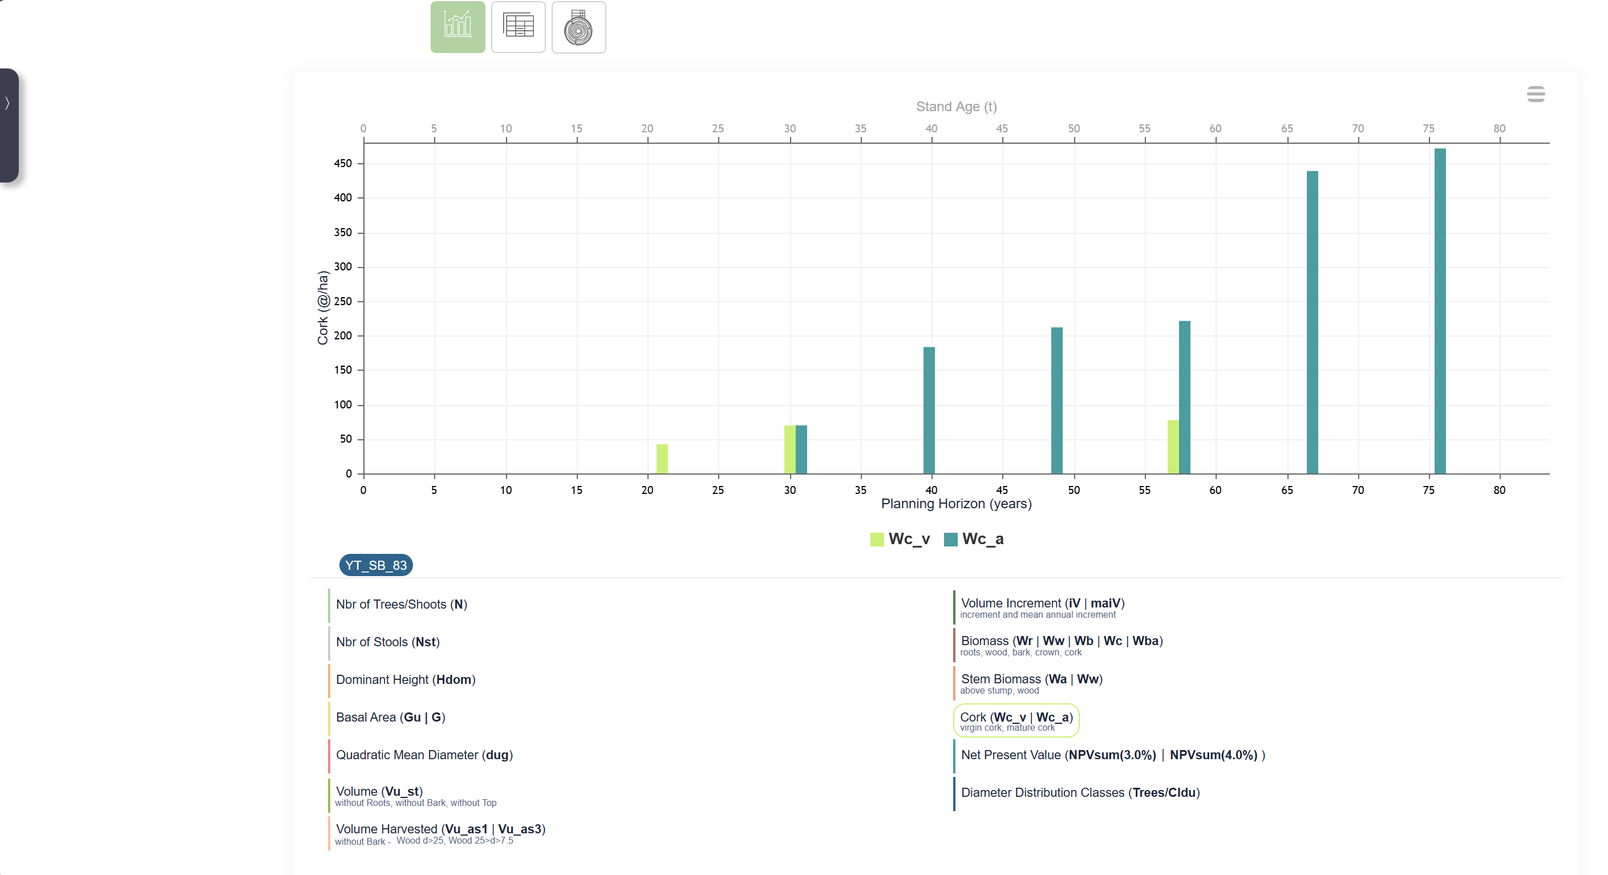
StandsSIM.md simflor.online SUBER Model – cork oak
SUBER v5.5 outputs in StandsSIM:
Cork harvest (@/ha) 1@ = 15kg

Slide 28
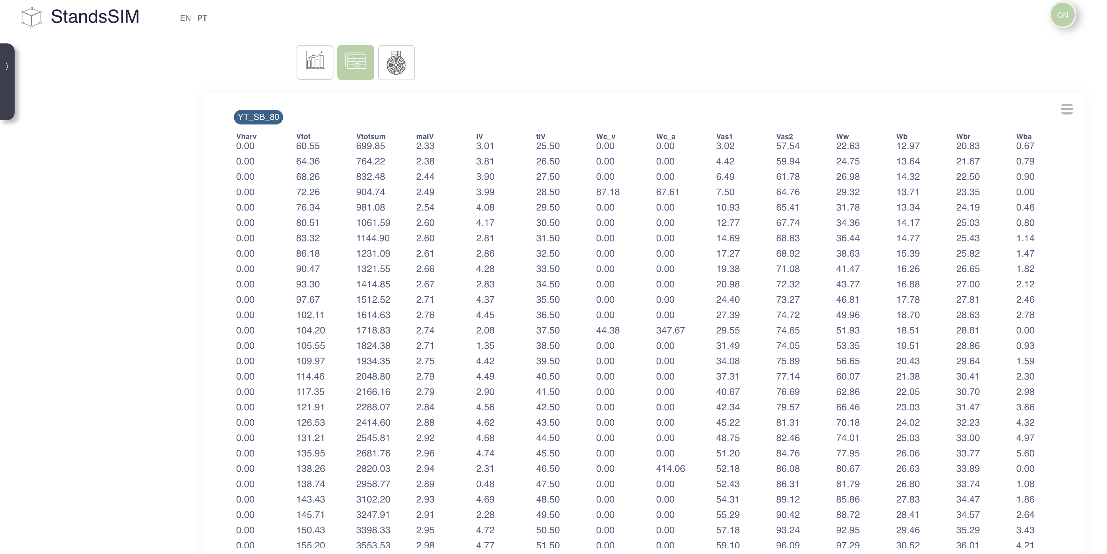
StandsSIM.md simflor.online SUBER Model – cork oak
SUBER v5.5 outputs in StandsSIM :
The difference in the results when compared with the results made available for other tree species in StandsSIM.md are mainly related to cork
Biomass (in @) of virgin (Wc_v) and mature (Wc_a) harvested cork per ha

Slide 29
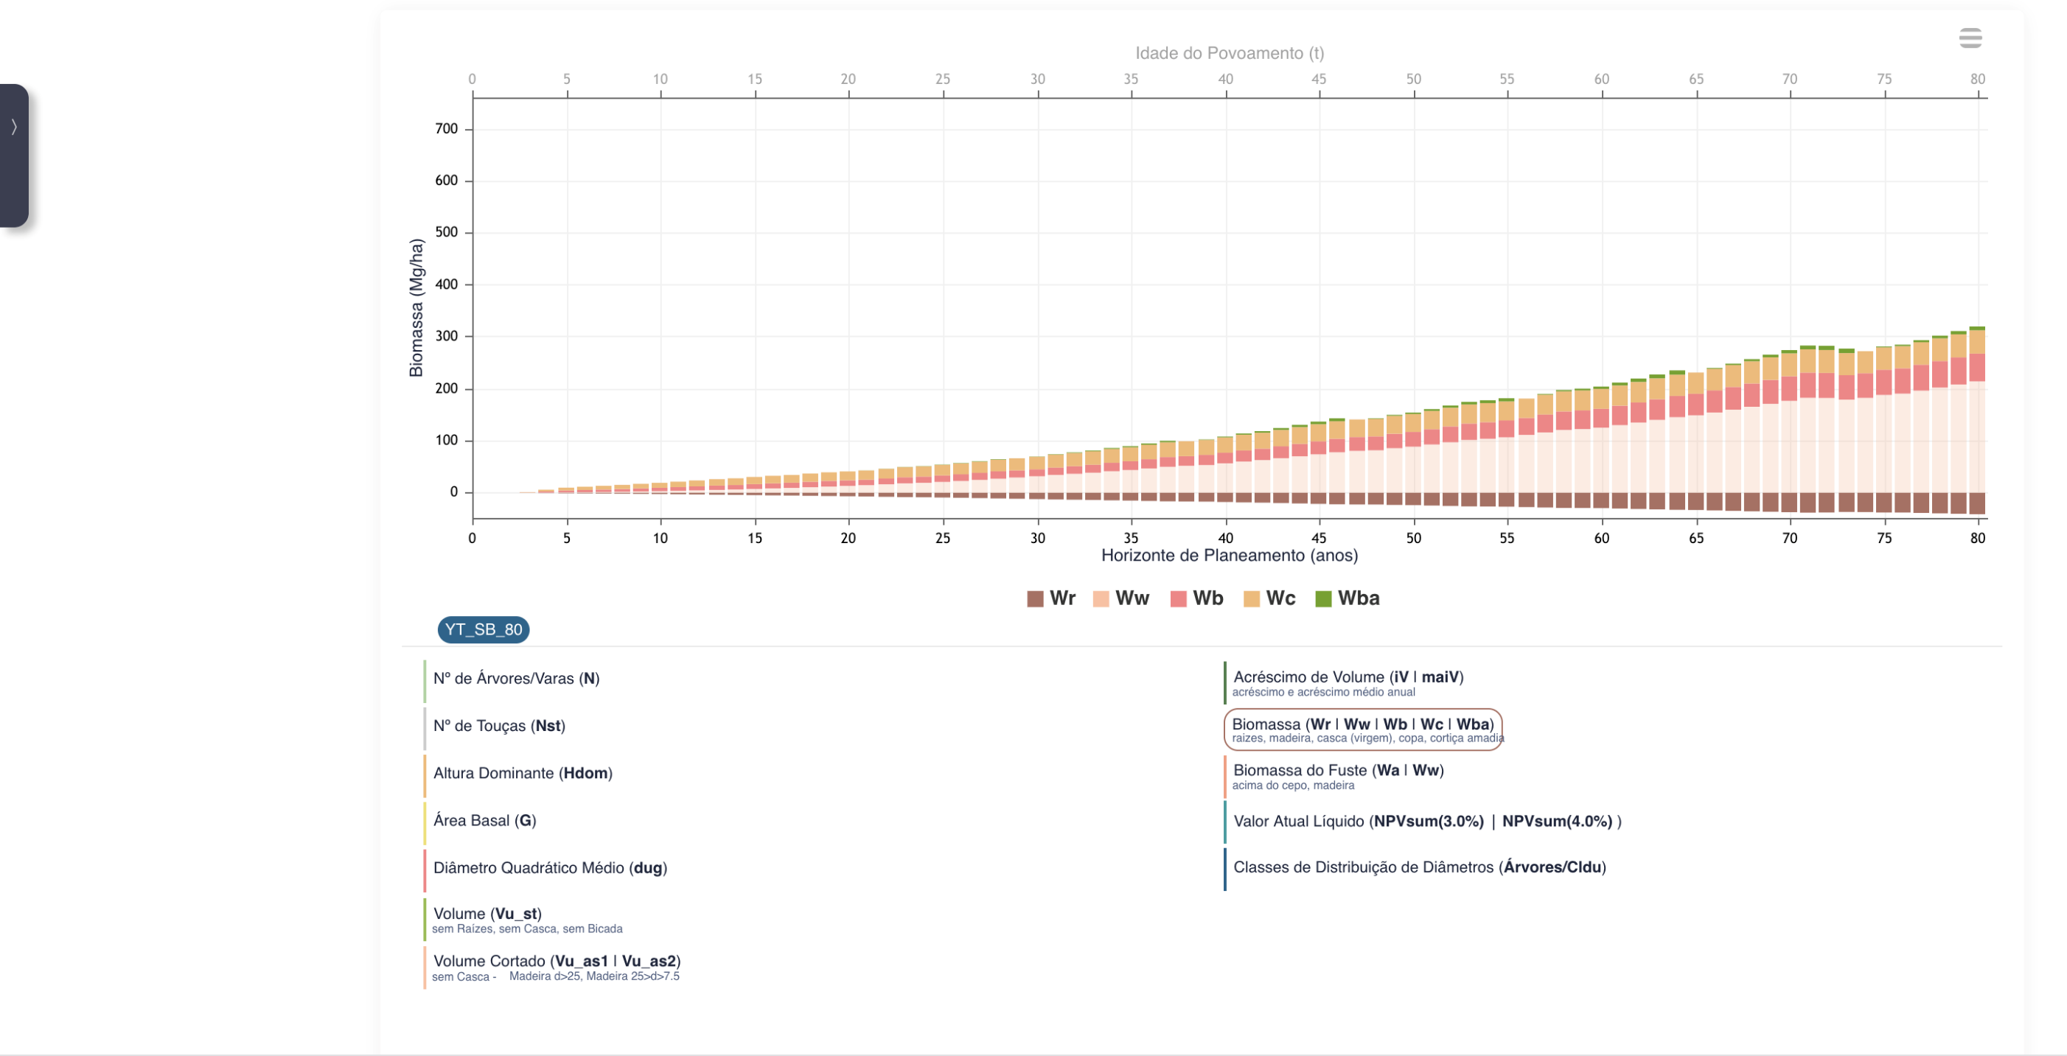
StandsSIM.md simflor.online SUBER Model – cork oak
SUBER v5.5 outputs in StandsSIM :
The difference in the results when compared with the results made available for other tree species in StandsSIM.md are mainly related to cork
Biomassas (em @) de Cortiça Virgem (Wc_v) e de Cortiça Amadia (Wc_a) por ha, extraídas nos descortiçamentos
Mature cork biomass(Wba) por ha, over the simulation period

Slide 30
StandsSIM.md simflor.online SUBER Model – cork oak
SUBER v5.5 outputs in StandsSIM :
The difference in the results when compared with the results made available for other tree species in StandsSIM.md is mainly related to cork
Given the inportance of cork less attention is paid to volumes leading to a smaller level of detail in volume estimates when compared to wood production species. Only stem volume is considered and canopy biomass as a whole (no distinction between leaves and branches.
Biomassas (em @) de Cortiça Virgem (Wc_v) e de Cortiça Amadia (Wc_a) por ha, extraídas nos descortiçamentos
SUBER v6 will allow integrating more updates in terms of improved growth equations and also alometroc equations that will contribute to making SUBER outputs more compatible with StandsSIM’s
Biomassa de Cortiça Amadia (Wba) por ha, presente nas árvores ao longo dos anos simulados

