Slide 1
ISA Presentation
Stand-Level Management Planning
Lecture 2 –Financial Analysis and Inflation
Monday, November 13, 2016

Slide 2
Lecture Outline
Inflation
What is inflation?
How is it measured?
Components of the Interest Rate
Nominal interest rate = inflation plus real interest rate
Factors affecting the real interest rate
Combining Interest Rates

Slide 3
Lecture Outline
Nominal and Real Values
Definitions
Deflating and Inflating
Definitions
Formulas
Key Facts and Rules for Financial Analyses with Inflation
Real Changes in Prices and Costs

Slide 4
Inflation
Inflation is an increase in the average price level, which reduces the purchasing power of the dollar (or any other currency).
Inflation is NOT the only – or even the main – reason why we need to discount or compound values to a common time frame, such as a present value.
Even without inflation, we would still have interest to account for time preference and the opportunity cost of using money.

Slide 5
Inflation
Inflation is an increase in the average price level, which reduces the purchasing power of the dollar (or any other currency).
The inflation rate is the average annual rate of increase in the price of goods.
Inflation is measured by a variety of indexes. The broadest and most commonly-used are the consumer price index (CPI) and the producer price index (PPI).
Note: you can get CPI and PPI data for all European Union countries (and many others) from www.inflation.eu.
American inflation data comes from the Bureau of Labor Statistics (www.bls.gov)

Slide 6
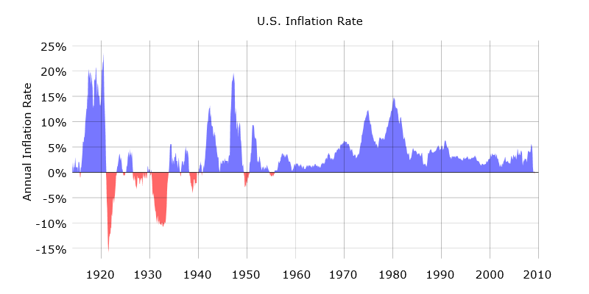
Historical US Inflation Rate

Slide 7
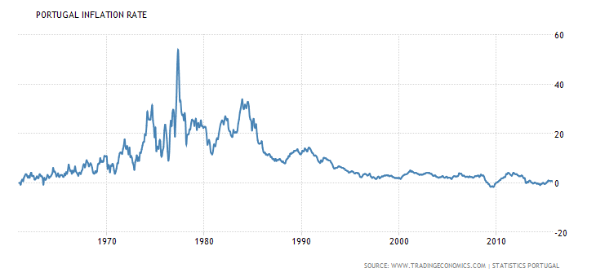
Historical Portuguese Inflation Rate

Slide 8
Inflation (continued)
The formula to calculate the average inflation rate between two points in time, using the CPI (or the PPI), is:
Do you recognize this formula?

Slide 9
Example: Calculating the Inflation Rate from the CPI
The CPI was 38.8 in 1970 and 229.6 in 2012. What was the average inflation rate, as measured by the CPI, between 1970 and 2012?
Answer:
$$k=\left[\sqrt[t_{2}−t_{1}]{\frac{{CPI}_{t_{2}}}{{CPI}_{t_{1}}}}\right]−1$$
$$k=\left[\sqrt[2012−1970]{\frac{229.6}{38.8}}\right]−1$$
$$k=\left[\sqrt[2012−1970]{\frac{229.6}{38.8}}\right]−1=0.4324=4.3\%$$

Slide 10
Interest Rates and Inflation

Slide 11
Nominal vs. Real Interest Rates
The nominal interest rate (sometimes simply called the nominal rate) is the interest rate that is quoted by banks, credit cards, stock brokers, etc.
The nominal rate includes both the cost of capital and inflation.
It is the rate you should use to discount actual, inflated future values (i.e., nominal future values).

Slide 12
Nominal vs. Real Interest Rates (continued)
The real interest rate (also called the real rate) is the rate earned on a capital investment or a loan above what is needed to account for inflation.
Specifically, inflation has been removed from the real interest rate.
The real interest rate should be used to discount future values that are expressed in current dollar values (i.e., real future values).

Slide 13
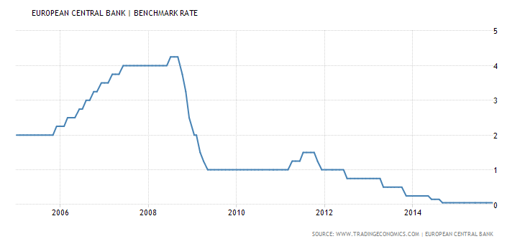
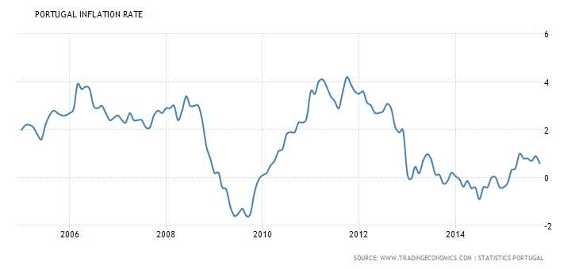
What was the real interest rate in 2012?

Slide 14
Components of the Interest Rate (Or, Why Interest Rates Are Not All the Same)
Nominal interest rate ≈ inflation + real interest rate.
Factors affecting the real interest rate:
risk – taxes
illiquidity – time period
transaction costs
Each of these factors adds a premium to the pure interest rate.

Slide 15
Components of the Interest Rate (continued)
The pure interest rate is the real rate of return earned by an imaginary, risk-free, perfectly liquid, tax-free investment with no transactions costs and a very short time period.
This is usually a very small number (~1-2%).
Then, add premiums for risk, taxes, illiquidity, time period and transactions costs.
This is the real interest rate.
Real interest rates can be negative.
Finally, add inflation:
This is the nominal interest rate.

Slide 16
Combining Interest Rates
The basic formula expressing the mathematical relationship between the nominal interest rate, the real interest rate, and the inflation rate is:
Where:
i = the nominal interest rate,
r = the real interest rate, and
k = the rate of inflation.

Slide 17
Combining Interest Rates (continued)
The basic formula can be solved for each of the three rates as a function of the other two:

Slide 18
Example: Solving for the Nominal Rate
If you wish to earn a real rate of at least 3% on an investment and you expect the inflation rate will be 4% during the investment period, what is the minimum nominal rate you must earn?

Slide 19
Example: Solving for the Real Rate
If the nominal interest rate earned on an investment was 8% and the inflation rate was 3% during the investment period, what real rate was earned on the investment?

Slide 20
Nominal and Real Values
A nominal value is a value expressed in the currency of the year in which the value occurs, i.e., a value that is expressed in dollars that have the purchasing power of dollars in the year when the value occurs.
A real value is a value that is expressed in terms of dollars with the same purchasing power as dollars today, or at any other meaningful reference point in time.

Slide 21
Deflating
Deflating is the process of converting a value expressed in the currency of a given point in time into a value with an equivalent amount of purchasing power expressed in the currency of an earlier time
For example, converting a value expressed in 2030 dollars to an equivalent value expressed in 2015 dollars.

Slide 22
Inflating
Inflating is the process of converting a value expressed in the currency of a given point in time into a value with an equivalent amount of purchasing power expressed in the currency of a later time
For example, converting a value expressed in 2015 dollars to an equivalent value expressed in 2030 dollars.

Slide 23
Deflating
Real Future
Values
Nominal Future
Values
Inflating
Future Values
$$V_{n}$$
k
$$V_{n}^{∗}$$
Discounting
Compounding
Compounding
Discounting
r
i
Present Value
$$V_{0}$$

Slide 24
Example: Inflating Using the CPI
A good starting salary for a person graduating from college in 1948 was $4,000 per year. What would be an equivalent salary today? (Note: the CPI for 1948 is 24.1, and the CPI for 2012 is 229.6).
Answer:
$${Salary}_{\$2012}={Salary}_{\$1948}×\frac{{CPI}_{t_{2}}}{{CPI}_{t_{1}}}$$
$${Salary}_{\$2012}=\$4,000×\frac{229.6}{24.1}$$
$${Salary}_{\$2012}=\$4,000×\frac{229.6}{24.1}=\$38,108$$

Slide 25
Deflating a Nominal Future Value
If you have a nominal future value and want to express it in current dollars, you need to deflate it using the expected inflation rate.
Formula for deflating future values using the expected inflation rate:
Where V_{n}* = the nominal future value

Slide 26
Example: Deflating a Future Value
If inflation averages 3% per year between 2015 and 2030, what will be the real value, in $2015, of a nominal value of $1,000 in 2030?
Answer:

Slide 27
Inflating a Real Future Value
If you have a real future value and want to express it in nominal dollars, you need to inflate it using the expected inflation rate.
Formula for inflating real future values using the expected inflation rate:

Slide 28
Example: Inflating a Future Value
You figure that you will need at least $450,000 in today’s dollars in savings to retire in comfort. If inflation averages 2.5% over the next 40 years, how much will you need in 2055 dollars to retire in comfort?
Answer:

Slide 29
Key Facts and Rules for Financial Analyses with Inflation
Real future values are uninflated; nominal future values are inflated.
Converting a nominal future value into a real future value is an example of deflating.
Converting a real future value to a nominal future value is an example of inflating.
To convert real future values to nominal future values or vice versa, you must use the inflation rate.

Slide 30
Key Facts and Rules for Financial Analyses with Inflation (continued)
To discount real future values, use a real interest rate.
To discount nominal future values, use a nominal interest rate.
Compounding a present value with a real interest rate results in a real future value.
Compounding a present value with a nominal interest rate results in a nominal future value.

Slide 31
One Final Example
A bond that you buy today matures in 10 years, at which time you will receive $1,000. This $1,000 is an actual amount that you will get paid; therefore it is a nominal amount.
How much should you pay today for the bond if it is expected to earn a nominal rate of 7%?
If you expect inflation to average 3% during the 10-year period until the bond matures, what real rate of return will you will earn on the bond?
What will be the real future value of the bond?

Slide 32
One Final Example
A bond that you buy today matures in 10 years, at which time you will receive $1,000. This $1,000 is an actual amount that you will get paid; therefore it is a nominal amount.
How much should you pay today for the bond if it is expected to earn a nominal rate of 7%?
Answer:

Slide 33
One Final Example
A bond that you buy today matures in 10 years, at which time you will receive $1,000. This $1,000 is an actual amount that you will get paid; therefore it is a nominal amount.
If you expect inflation to average 3% during the 10-year period until the bond matures, what real rate of return will you will earn on the bond?
Answer:

Slide 34
One Final Example
A bond that you buy today matures in 10 years, at which time you will receive $1,000. This $1,000 is an actual amount that you will get paid; therefore it is a nominal amount.
What will be the real future value of the bond?
There are two ways of answering this question:
deflate the nominal future value, or
compound the present value using the real interest rate we calculated above.
Both should give the same answer.

Slide 35
One Final Example
A bond that you buy today matures in 10 years, at which time you will receive $1,000. This $1,000 is an actual amount that you will get paid; therefore it is a nominal amount.
What will be the real future value of the bond?
Method 1: Deflating the nominal future value:

Slide 36
One Final Example
A bond that you buy today matures in 10 years, at which time you will receive $1,000. This $1,000 is an actual amount that you will get paid; therefore it is a nominal amount.
What will be the real future value of the bond?
Method 2: compounding the present value using the real interest rate we calculated above :

Slide 37
Deflating
Real Future
Values
Nominal Future
Values
Inflating
Future Values
$$\$744.09=V_{n}$$
k
$$V_{n}^{∗}=\$1,000$$
Discounting
Compounding
Compounding
Discounting
r
i
Present Value
$V_{0}$=$508.35

