Slide 1
ISA Presentation
Stand-Level Management Planning
Lecture 1 – Introduction to Financial Analysis
Monday, November 13, 2016

Slide 2
Plan for the McDill Lectures
What is Financial Analysis?
Financial analysis in a world with inflation
Financial Analysis of Even-aged Management Decisions
Sensitivity analysis of the optimal rotation
Financial Analysis of Uneven-aged Management Decisions

Slide 3
Lecture Outline
Discounting
What is discounting?
What is the difference between a present and future value?
Time preference
Opportunity cost

Slide 4
Lecture Outline (continued)
Interest
What is interest?
Discounting Formulas
Single-value Formula
Infinite Annual Series
Infinite Periodic Series
Finite Annual Series
Finite Periodic Series

Slide 5
Why Learn about Financial Analysis in forestry classes?
Even public agencies should strive to achieve their objectives in a financially efficient way.
Natural resources management alternatives provide different returns at different times. How can you compare them financially?

Slide 6
Why Learn About Financial Analysis?
Forests and other natural resources are valuable assets. If natural resources managers don’t understand financial analysis, these assets will be managed by people who do - accountants and business majors.
Financial analysis will be useful to you in managing your own personal finances: loans, mortgages, retirement, and investments.

Slide 7
What is Discounting?
Simple Definitions
Discounting is the process of converting future values to present values
Compounding is the reverse process: converting present values to future values
A present value is a value that is expressed in terms of dollars received immediately
A future value is a value that is expressed in terms of dollars received at some future time

Slide 8
More Accurate Definitions
Discounting is the process of converting a value that is expressed in terms of dollars received at one point in time to an equivalent value expressed in terms of dollars received at an earlier point in time.
Compounding is the process of converting a value that is expressed in terms of dollars received at one point in time to an equivalent value expressed in terms of dollars received at a later point in time.

Slide 9
Why Discount?
Why is the value of $100 different when it is received at different times?
“Time value” of money
People prefer to have things today rather than wait (time preference)
Money can be invested and earn more money in the future (opportunity cost)
If you want to use someone else’s money, you have to pay them “rent” on the money (asset value)

Slide 10
What is Interest?
Interest is the money that you pay to borrow money.
Interest is the money that your investments earn when you lend money.
The interest rate is the percentage of the amount borrowed that is paid in interest after one unit of time – usually a year.
Interest can also be viewed as an exchange rate between dollars today and dollars one year from now.

Slide 11
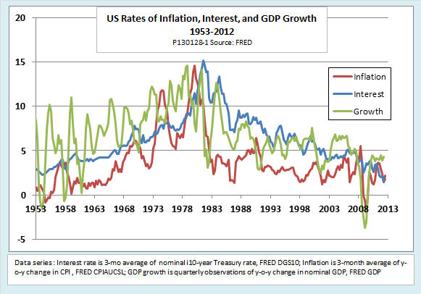
Interest Rates Vary Over Time

Slide 12
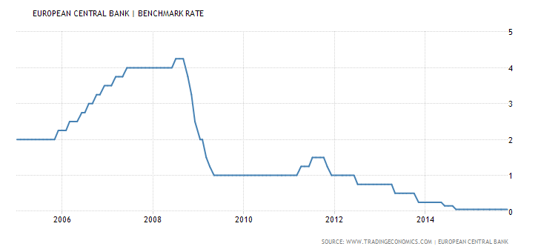
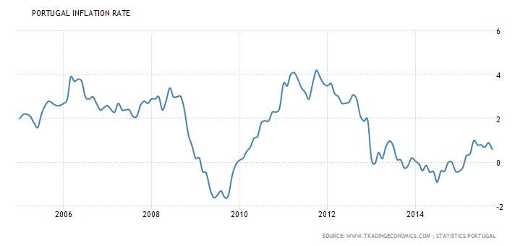
Interest Rates Vary Over Time

Slide 13
Interest Rates are Different for Different Borrowers and for Different Purposes
Why are interest rates different for different borrowers?
How risky are you?
How risky is the purpose for which the money will be used?
How long will the money be tied up in the investment?

Slide 14
Using the Interest Rate to Convert Values Earned One Year Apart
Let
V₀ = the amount in the account today
V₁ = the amount in the account in one year
i = the interest rate earned on the account in one period
Now, if you make no further deposits or withdrawals, the amount you will have in the account in one year is a function of the current amount in the account and the interest rate:
V₁ = V₀ + iV₀ = principal + interest
or:
V₁ = (1 + i) V₀

Slide 15
Using the Interest Rate to Convert Values Earned Two Years Apart
Let
V₂ = the amount in the account in 2 years
Now, we know that:
V₁ = (1 + i) V₀
and
V₂ = (1 + i) V₁
So, combining these equations gives:
V₂ = (1 + i) (1 + i) V₀ = (1 + i)² V₀
Generalizing this line of reasoning gives:
V_{n} = (1 + i)^{n} V₀

Slide 16
The Single Value Formula
Gives the present value (V₀ ) of a value that occurs in year n (V_{n} ), given the interest rate i:

Slide 17
Example 1
What is the present value, using a discount rate of 8%, of $1,000 to be received in 30 years?
Notes:
Insert Present Value Example

Slide 18
Example 2
A release treatment that occurs in a pine plantation at age 4 costs $60/ac. With or without the release treatment, the stand in question would be harvested at age 25. How much must the release treatment add to the harvest revenue at age 25 in order to return a rate of return of at least 6% on the $60/ac investment?
In order to earn at least 6%, the additional revenue at age 25 that results from the release treatment must be greater than or equal to the future value of the $60/ac cost at age 4, compounded over 21 years at 6%.

Slide 19
Example 3
What rate of return is earned on an investment that doubles your money in ten years?
Assume that we invest $1 today and earn $2 in 10 years. Then apply the interest rate version of the formula:

Slide 20
The Rule of 72
You can estimate the rate of return on an investment if you know the time it takes for an investment to double your money. The rule can also be used to determine how long it takes to double your money when you know the interest rate.
To estimate the rate of return, divide 72 by the number of years to double your money.
To estimate how long it takes to double your money, divide 72 by the interest rate.

Slide 21
Infinite Annual Series
This formula gives the present value (V₀) of an infinite series of annual payments of R dollars, given the interest rate i:
Explanation: consider how much you would earn annually from an investment if you take out the interest each year and keep the original capital intact:
This formula is the same as the one above (you can obtain the one above by rearranging this one, or vice versa).

Slide 22
Example 4
If your farm land earns a net income of $100/ac/yr and your alternate rate of return is 8%, how much is it worth?

Slide 23
Example 5
If you purchase some farm land for $1,800/ac and your alternate rate of return is 8%, how much should you expect to earn from the farm per year?
Notes:
Insert annual series example.

Slide 24
Infinite Periodic Series
This formula is used to identify the present value (V₀), given an interest rate (i), of an infinite series of regular payments (R) that are made every t years:
Note that the term in the denominator is just the amount of interest you will earn on the investment in t years, so the infinite annual series formula we just learned is a special case of this formula where t = 1.

Slide 25
Infinite Periodic Series Example
Consider a Populus spp. stand that regenerates naturally, so there is no regeneration cost. Also, for simplicity, assume that there are no taxes on the property. Every 40 years, the stand can be harvested to yield, on average, 30 cords of pulpwood at an estimated price of $6 per cord (i.e.. $180 per acre every 40 yr). Assuming there are no taxes or other costs, and that the discount rate is 3%, what is the value of the land (per acre) when used for growing aspen?
Note that the value of any asset is given by the present value of the expected present and future costs and revenues accrued by owning the asset. Thus, the value of the land on which the Populus stand is grown is the present value of the infinite periodic series of $180/ac, earned every 40 years.

Slide 26
Infinite Periodic Series Example Answer
Use the infinite periodic series formula
Revenue = $180 every 40 yr
Interest rate = 3%

Slide 27
Finite Annual Series
This formula is used to calculate the present value (V₀), at an interest rate i, of a regular, annual payment (R ) that is made for a fixed number of years (n).
The formula can be rearranged to calculate the value of the payment:

Slide 28
Finite Annual Series
This formula is used to calculate the present value (V₀), at an interest rate i, of a regular, annual payment (R ) that is made for a fixed number of years (n).
Or it can be rearranged to calculate the future value of the series:

Slide 29
Finite Annual Series Example:
Consider an even-aged northern hardwood stand that is managed on an 80-year rotation with no intermediate revenues – i.e., the only revenue earned from the stand is from the final harvest at age 80. At an interest rate of 8%, how much revenue (per acre) must be earned from this final harvest to pay for an annual property tax of $2/ac that is paid each year from age 1 to age 80?
Answer:

Slide 30
Equivalent Monthly Interest Rate
The finite annual series is often used to calculate the payment amount for a loan. However, loans are often paid in monthly, rather than yearly, amounts.
Most banks use the following formula to calculate the interest rate.
$i_{m}=i/{12}$
The following formula gives the “true” equivalent monthly interest rate:
$i_{m}={\left(1+i\right)}^{1/{12}}−1$

Slide 31
Equivalent Monthly Interest Rate (continued)
To calculate the payment for a monthly loan,
use the version of the finite annual series formula that solves for the payment,
use the monthly rate instead of the annual rate, and
use the number of months instead of the number of years.

Slide 32
Monthly Loan Payment Example
Suppose you want to take out a loan for a car. You want to borrow $10,000 over a 3-yr period at an annual interest rate of 9.5%. How much will your payment be?
Answer: first calculate the monthly interest rate:

Slide 33
Monthly Loan Payment Example
Suppose you want to take out a loan for a car. You want to borrow $10,000 over a 3-yr period at an annual interest rate of 9.5%. How much will your payment be?
Next calculate the payment:

Slide 34
Finite Periodic Series
This formula is used to solve for the present value, at an interest rate i, of a regular, periodic payment (R) that is received every t years, which ends after a fixed number of years (n).

Slide 35
Process for Solving Financial Analysis Problems
Read the problem.
Determine which formula(s) you will need.
Possibly use a cash flow diagram
Determine how the data should be used in the formula.
Do the calculations.
Does the answer make sense?

Slide 36
Determining Which Formula to Use
1. Does the problem involve a series of equal revenues or payments?
Yes: Go to Question 2
No: You need to use the single-value formula. If multiple values are involved, you will probably need to apply the formula separately to each value.
2. Is the series of revenues or payments annual or periodic?
Annual: Go to Question 3
Periodic: Go to Question 4

Slide 37
Determining Which Formula to Use (continued)
3. (Annual Series) Does the series of annual revenues or payments end at a specific time, or is it infinite?
Specific: Use the finite annual series formula
Infinite: Use the infinite annual series formula
4. (Periodic Series) Does the series of periodic revenues or payments end at a specific time, or is it infinite?
Specific: Use the finite periodic series formula
Infinite: Use the infinite periodic series formula

