Slide 1
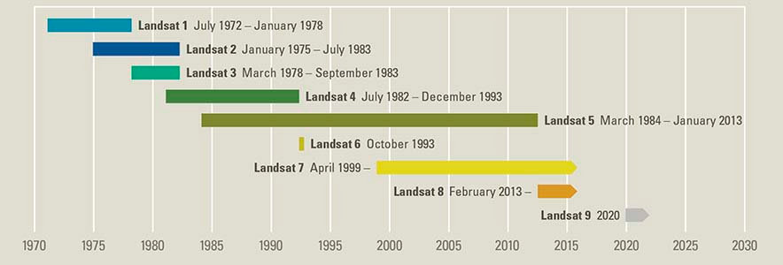

Slide 2
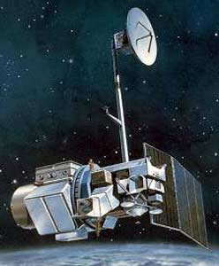
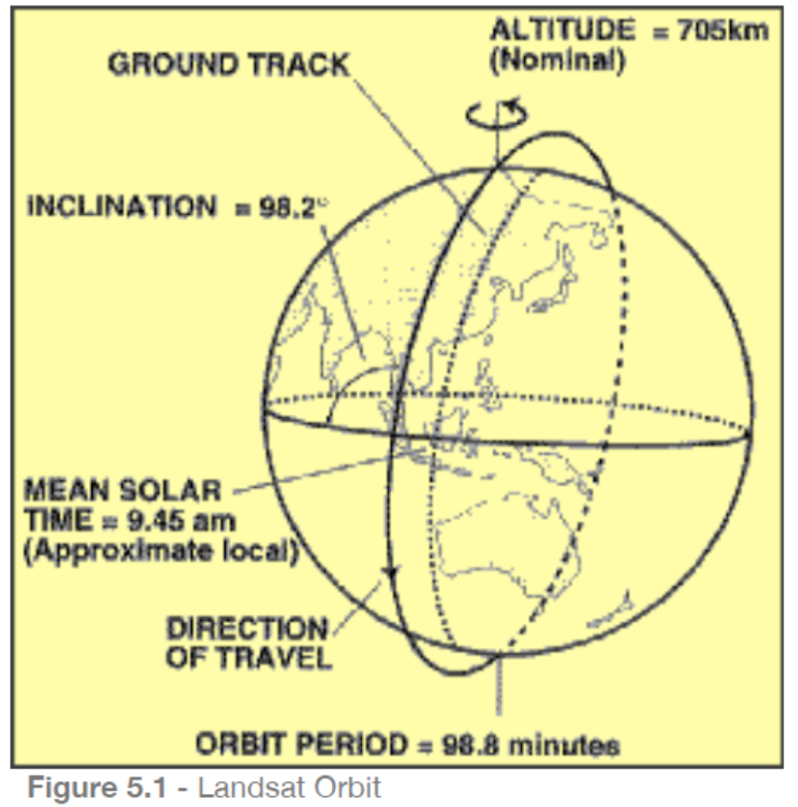
Landsat 5, 1.3.84 – 5.6.13
Orbit
Worldwide Reference System-2 (WRS-2)
path/row system
Circular, sun-synchronous, near-polar orbit
at an altitude of 705 km
Inclined at 98.2°
Repeat cycle: 16 days
Swath width: 185 km
Equatorial crossing time:
9:45 a.m. +/- 15 minutes

Slide 3
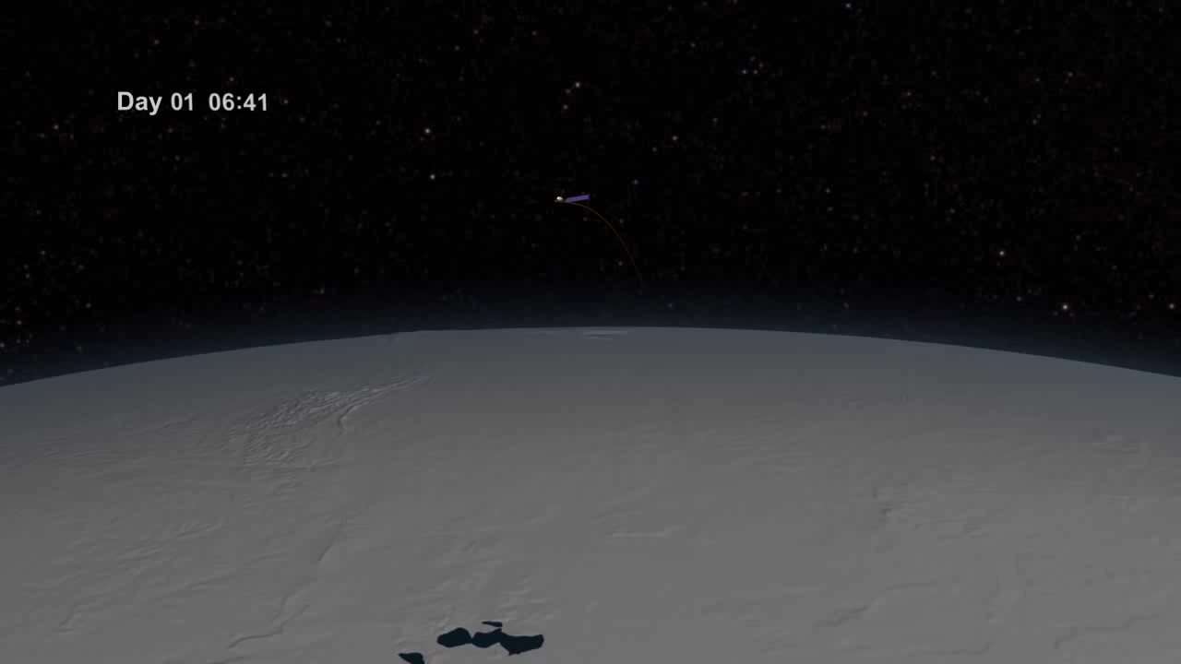

Slide 5
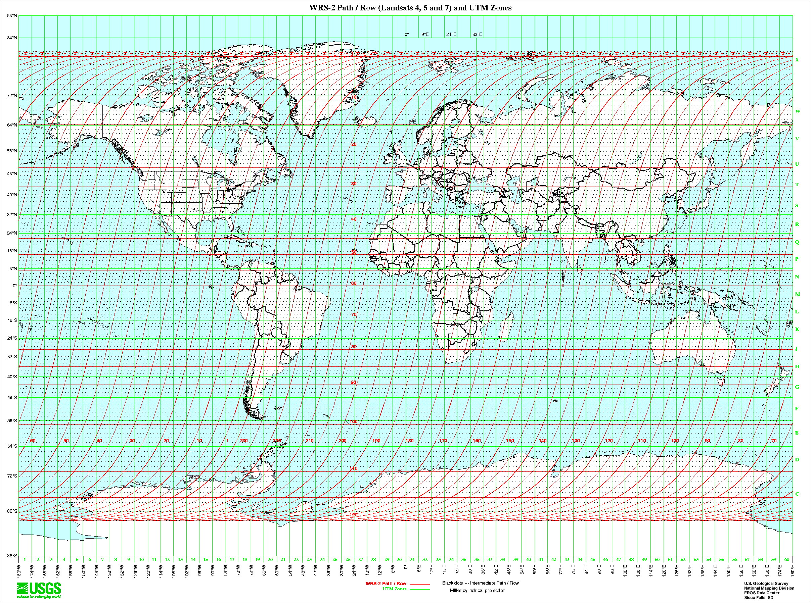

Slide 7
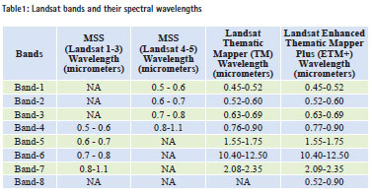

Slide 8
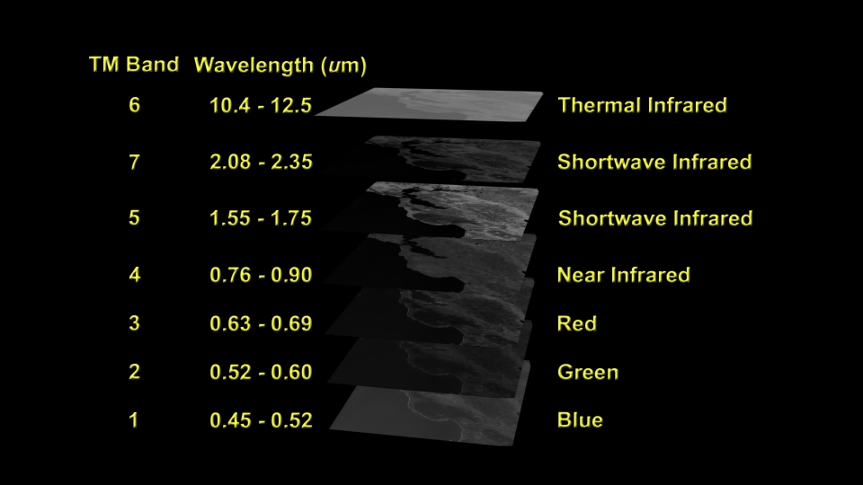

Slide 9
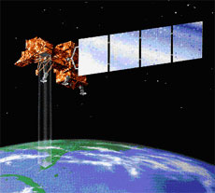
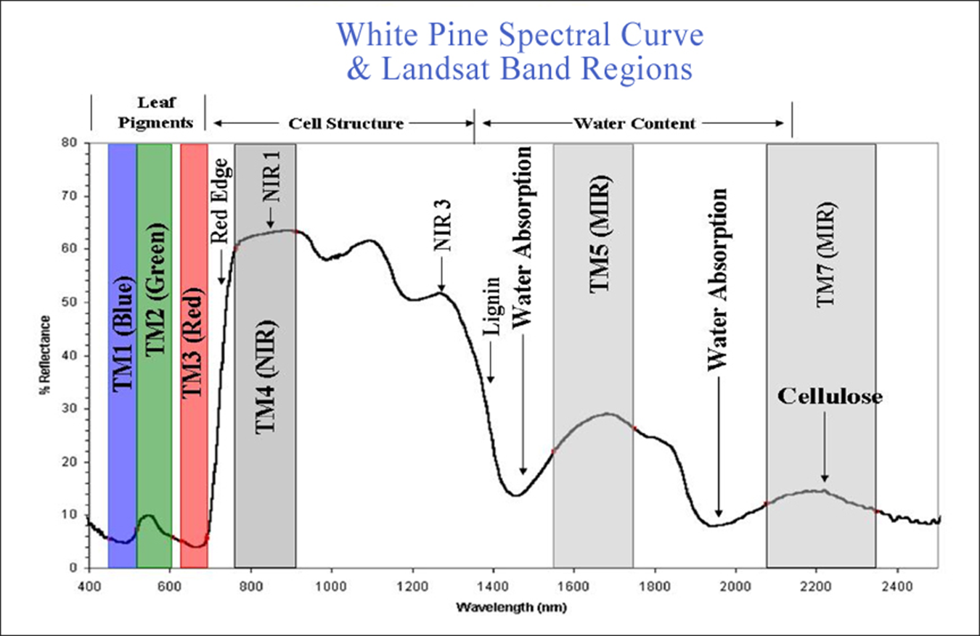
Orbit
Worldwide Reference System-2 (WRS-2) path/row system
Sun-synchronous orbit at an altitude of 705 km
233 orbit cycle; covers the entire globe every 16 days (except for the highest polar latitudes)
Inclined 98.2° (slightly retrograde)
Circles the Earth every 98.9 minutes
Equatorial crossing time: 10:00 a.m. +/- 15 minutes
Landsat 7, 15.4.99 - present

Slide 10
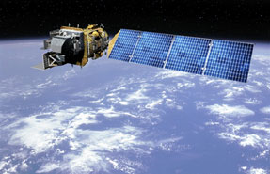
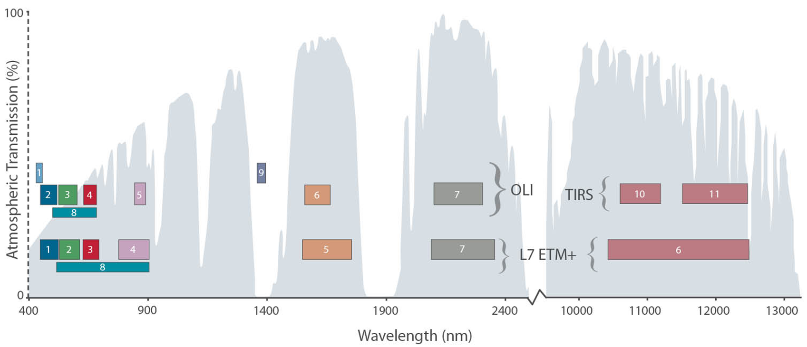
Orbit
Worldwide Reference System-2 (WRS-2) path/row system
Sun-synchronous orbit at an altitude of 705 km
233 orbit cycle; covers the entire globe every 16 days (except for the highest polar latitudes)
Inclined 98.2° (slightly retrograde)
Circles the Earth every 98.9 minutes
Equatorial crossing time: 10:00 a.m. +/- 15 minutes
Landsat 8, 11.2.13 - present

Slide 11
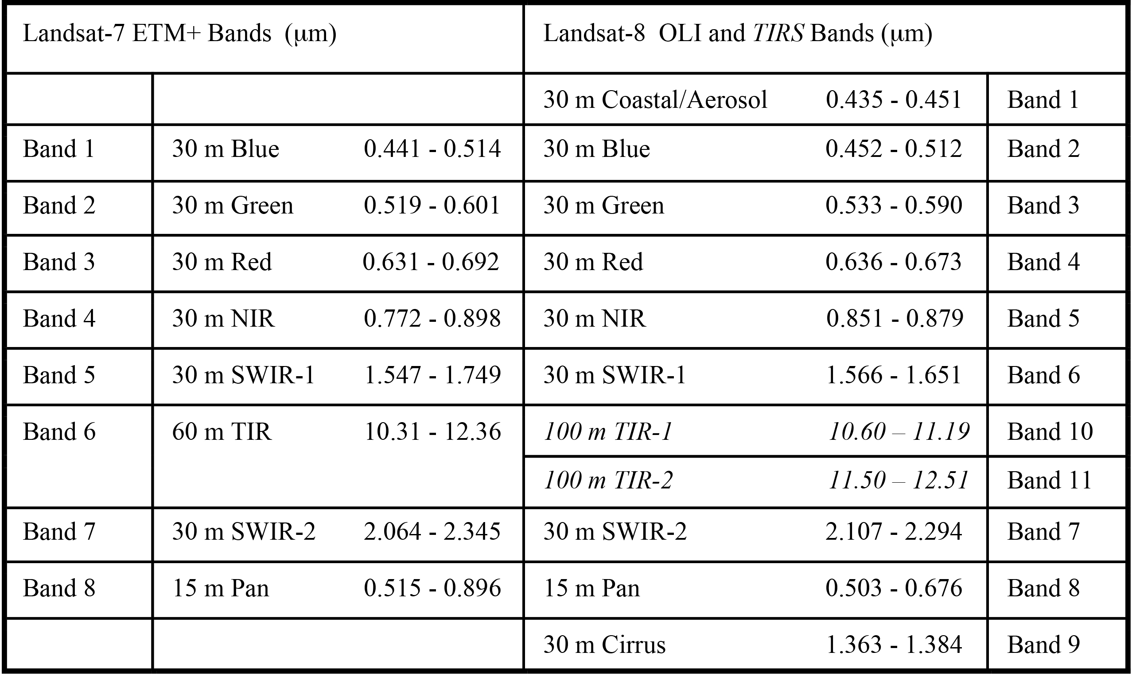

Slide 12
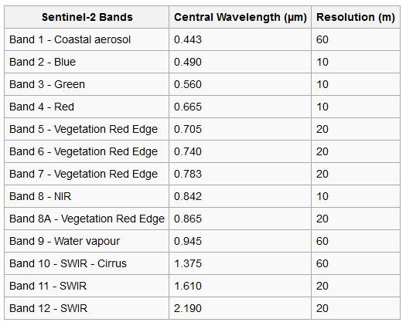

Slide 13
